Slide 1

Understanding the COVID Curve
Karuthan Chinna, PhD
Associate Professor
School of Medicine
Faculty of Health and Medical Sciences
Taylor’s University
Malaysia

Slide 2
Content
Epidemic Curve
Some Compartmental Models in Epidemiology
COVID-19 Model
Flatten the COVID-19 Curve

Slide 3
EPIDEMIC CURVE
An epidemic curve is known as an epi curve or epidemiological curve
It is a statistical chart used to visualize the onset and progression of a disease outbreak
Epi curves typically display a graph of the onset of illness among cases in an outbreak.
  Horizontal axis shows the date of illness onset among cases.
  Vertical axis shows the number of cases.
For the COVID-19 outbreak, major agencies display cases differently:
  World Health Organization (WHO) – show graphs based on the date of case reporting
  US Centre for Disease Control (CDC) used to displays cases by onset of illness.
  Of late CDC has also started to report cumulative cases based on date of reporting

Slide 4
COVID CURVE
In COVID pandemic…
The “CURVE" refers to the projected number of people who will contract COVID-19 disease over a period of time.
This is not a hard prediction, but a theoretical number used to model the virus' spread
The curve takes on different shapes, depending on the virus's infection rate.
In a steep curve, the virus spreads exponentially and the total number of cases skyrockets to its peak in a short time.
Infection curves with a steep rise also have a steep fall
A after the virus infects pretty much everyone who can be infected, case numbers begin to drop exponentially, too.

Slide 5
COMPARTMENTAL MODELS IN EPIDEMIOLOGY
SIS Model
SIR Model
SEIR Model
Modified SEIR Models

Slide 6
(1) SIS: SUSCEPTIBLE, INFECTIOUS
Susceptible
(S)
Infectious
(I)
No long lasting immunity
Susceptible: Individuals who are not infected, however, could become infected
Infectious: Individuals who have already been infected

Slide 7
(2) SIR: SUSCEPTIBLE, INFECTIOUS, RECOVERED
Susceptible
(S)
Infectious
(I)
Recovered
(R)
There is a lasting immunity
Susceptible: Individuals who are not infected, however, could become infected
Infectious: Individuals who have already been infected
Recovered: Individuals who have recovered from and are assumed to be immune

Slide 8
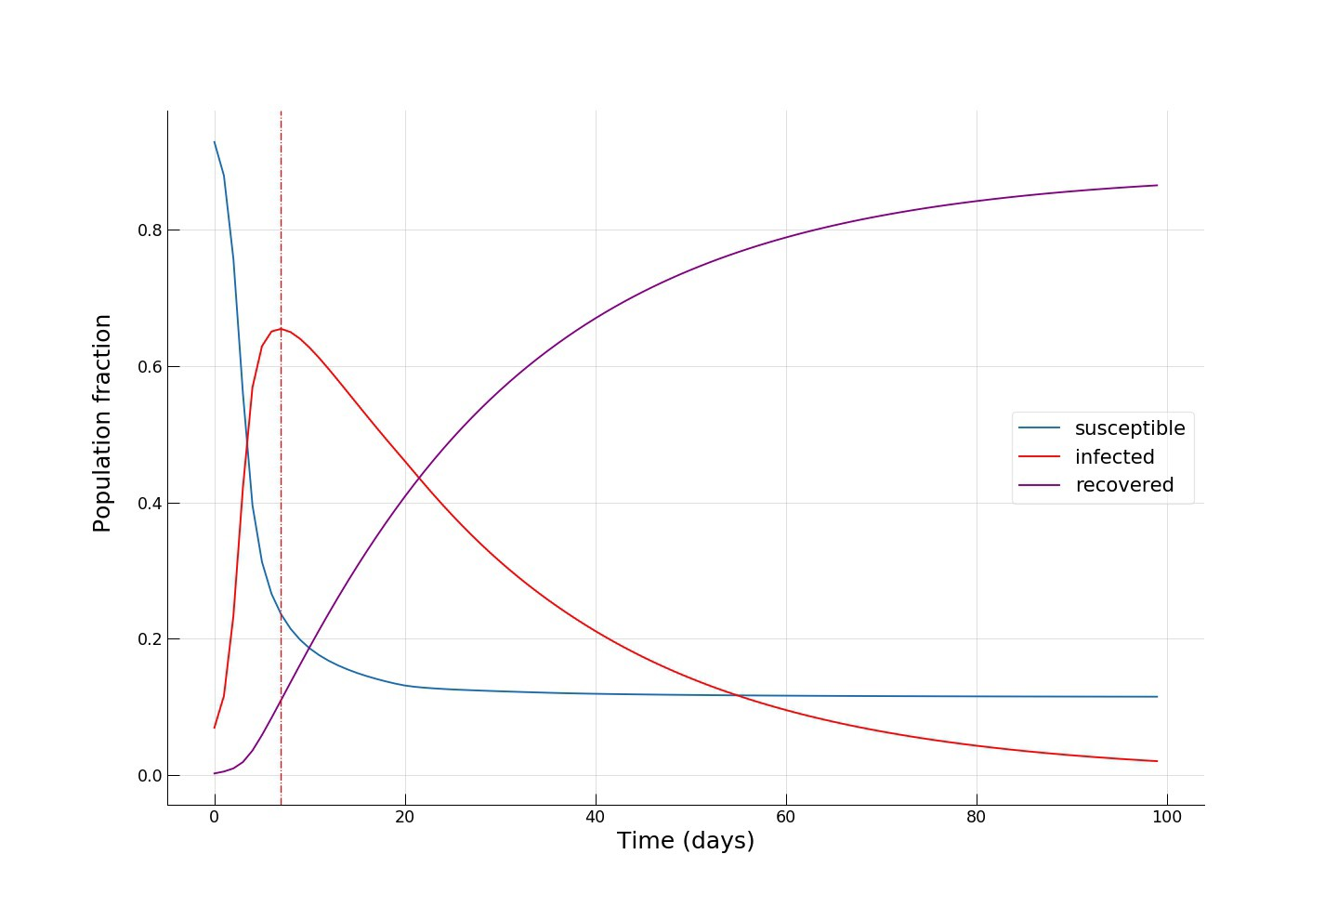
(2) SIR: SUSCEPTIBLE, INFECTIOUS, RECOVERED

Slide 9
(3) SEIR: SUSCEPTIBLE, EXPOSED, INFECTIOUS, RECOVERED
Susceptible
(S)
Exposed
(E)
Infectious
(I)
Recovered
(Immune)
(R)
Susceptible: Individuals who are not infected, however, could become infected
Exposed: Individuals who have been infected but are not yet infectious themselves
Infectious: Individuals who have already been infected
Recovered: Individuals who have recovered from and are assumed to be immune

Slide 10
(4) SEIR: SUSCEPTIBLE, EXPOSED, INFECTIOUS, RECOVERED
Infectious
(Asymptomatic)
(IA)
Susceptible
(S)
Exposed
(E)
Recovered
(Immune)
(R)
Infectious
(Symptomatic)
(IS)
This is the model that is used for COVID-19 Modelling

Slide 11
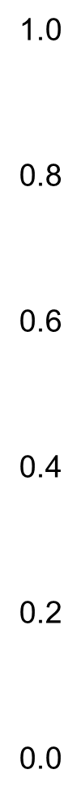
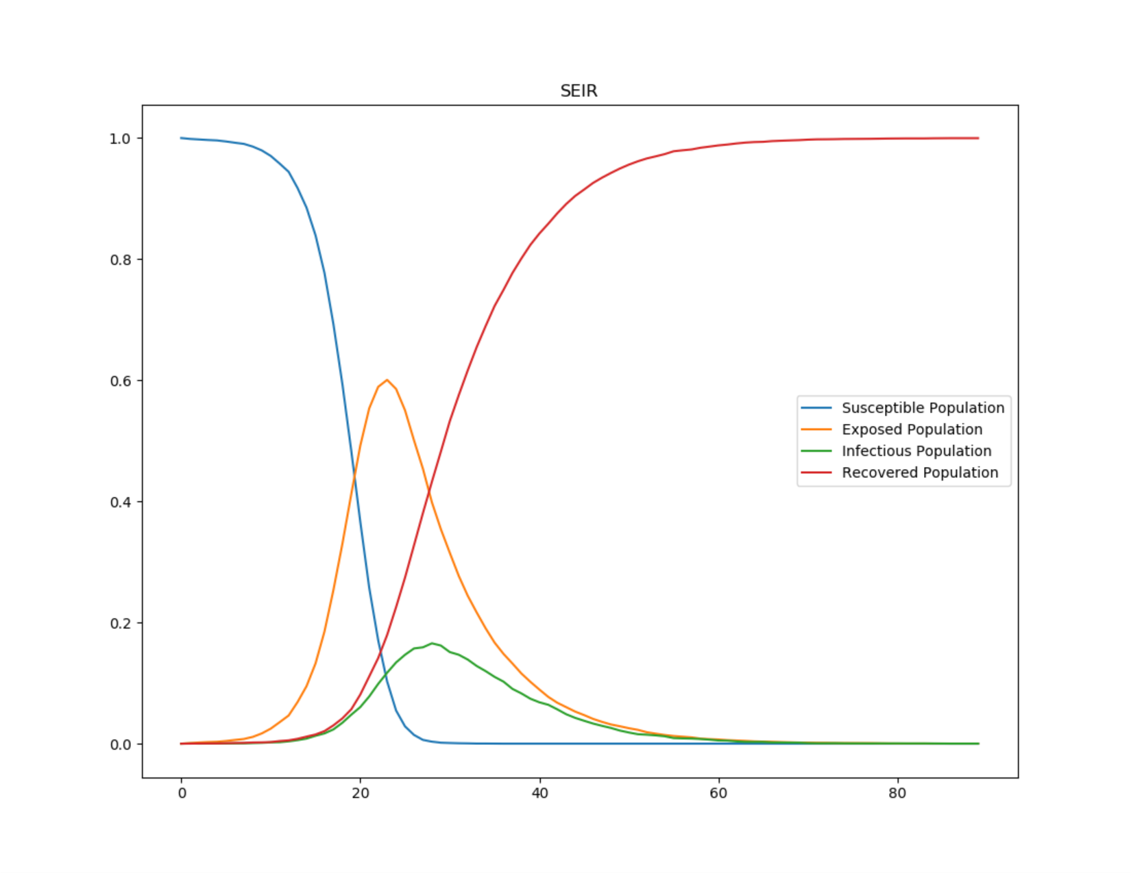
SEIR: SUSCEPTIBLE, EXPOSED, INFECTIOUS, RECOVERED
0 20 40 60 80 100
Day

Slide 12
(5) A MODIFIED SEIR: SUSCEPTIBLE, EXPOSED, INFECTIOUS,
RECOVERED, QUARANTINE, HOSPITALIZED
Infectious
(Asymptomatic)
(IA)
Susceptible
(S)
Exposed
(E)
Recovered
(Immune)
(R)
Infectious
(Symptomatic)
(IS)
Quarantine
(Q)
Hospitalized
(H)
He, S., Peng, Y. & Sun, K (2020)

Slide 13
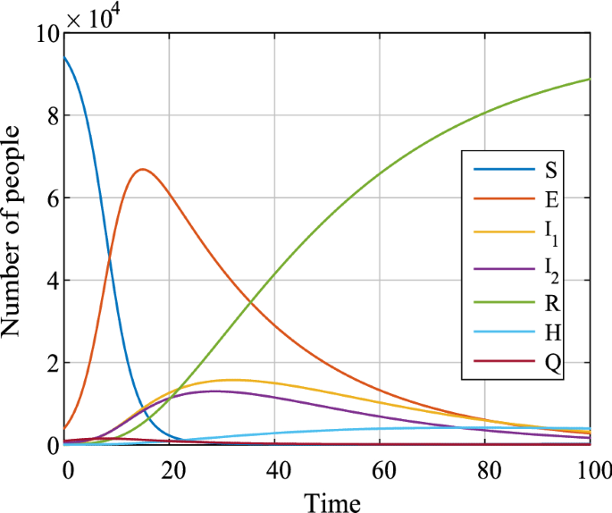
(5) A MODIFIED SEIR: SUSCEPTIBLE, EXPOSED, INFECTIOUS,
RECOVERED, QUARANTINE, HOSPITALIZED

Slide 14
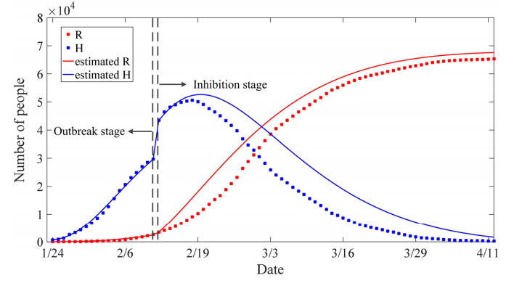
MODIFIED SEIR: ACTUAL & PREDICTED RECOVERED, HOSPITALISED
He, S., Peng, Y. & Sun, K (2020)

Slide 15
Next…
FLATTEN THE CURVE

Slide 16
CASES OVER TIME – the CURVE
We started with come epidemiological models
CASES
TIME

Slide 17
COMPARISON OF CURVES
CASES
CASES
TIME
TIME

Slide 18
TE SLOPE MATTERS
For the same total number of cases
Steep slope
Cases rise fast
Gentle slope
Cases rise slowly
CASES
CASES
TIME
TIME

Slide 19
WHAT DIFFERENCE DOES THE SLOPE MAKE
The faster the curve rises, the quicker the health care system gets overloaded beyond its capacity
As a consequence;
patients are forced to go without ICU beds
hospitals run out of the basic supplies.
A flatter curve assumes the same number of people ultimately get infected, but over a longer period of time.
This means;
less stressed health care system
fewer hospital visits on any given day
fewer sick people being turned away.

Slide 20
IMPACT ON HEALTHCARE SYSTEM
Problem
Wards, ICU beds, PPEs
Intubation facilities, etc.
CASES
HEALTHCARE SYSTEM CAPACITY
TIME

Slide 21
FLATTEN THE CURVE
Solution 1
50 wards, 20 ICU beds
IMPROVE HEALTH CARE SYSTEM CAPACITY
5 wards, 10 ICU beds
CASES
HEALTH CARE SYSTEM CAPACITY
TIME

Slide 22
FLATTEN THE CURVE
Solution 2
CASES
Collection Action:
‘Gentle’ the slope
TIME

Slide 23
FLATTEN THE CURVE
Solution 2…
No Intervention
CASES
With some collective action
TIME

Slide 24
FLATTEN THE CURVE
Solution 2…
No Intervention
CASES
HEALTH CARE SYSTEM CAPACITY
With Collective Action
TIME

Slide 25
FLATTEN THE CURVE
Solution 2…
No Intervention
Collective Action
Personal: Hygiene & Safety Measures
Community: Social Distancing
Environmental: Cleaning Surfaces
Enforcement: MCO
CASES
HEALTH CARE SYSTEM CAPACITY
With Collective Action
TIME

Slide 26
FLATTEN THE CURVE
Without speedy and coordinated public health actions such as
  rapid testing,
  isolation of cases
  social distancing
  stay-at-home policies (MCOs)
  the number of COVID-19 cases could rise beyond the capacity of the healthcare system
The goal is to "flatten" the curve – reduce the daily rate of new cases so that the number of severe cases can be handled effectively by the healthcare system.
Note that public health actions taken to "flatten the curve" do not guarantee the reduction in total number of cases during a pandemic.
That will be determined by additional factors such the speed by which other effective prevention measures e.g., vaccination against the virus

Slide 27
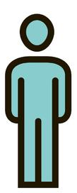

The toilet analogy - Charles Bergquist
Many people
One toilet

Slide 28
The toilet analogy
Solution 1
Many people
Many toilets

Slide 29
The toilet analogy
Solution 2
Many toilets
Many people

Slide 30
Some references
He, S., Peng, Y. & Sun, K. SEIR modeling of the COVID-19 and its dynamics. Nonlinear Dyn 101, 1667–1680 (2020). https://doi.org/10.1007/s11071-020-05743-y
Zhou Tang, Z, Li, X, Li, H (2020) Prediction of New Coronavirus Infection Based on a Modified SEIR Model medRxiv 2020.03.03.20030858;
Cooper, I, Mondal, A, and Chris G. Antonopoulos, C.G (2020) A SIR model assumption for the spread of COVID-19 in different communities. Chaos Solitons Fractals. 2020 Oct; 139: 110057
Mwalili et al. (2020) SEIR model for COVID‑19 dynamics incorporating the environment and social distancing BMC Res Notes13:352
Gaeta, G. (2020) A simple SIR model with a large set of asymptomatic infectives. ArXiv preprint, arXiv:2003.08720 (2020).
Li et al (2020). Propagation analysis and prediction of the COVID-19. Infectious Disease Modelling 5, 282e292
Hellewell, J. et al. (2020) Feasibility of controlling COVID-19 outbreaks by isolation of cases and contacts. The Lancet Global Health 8, 488‒496
Grimm, V., Mengel, F. & Schmidt, M. Extensions of the SEIR model for the analysis of tailored social distancing and tracing approaches to cope with COVID-19. Sci Rep 11, 4214 (2021).

Slide 31
Thank You

