Slide 1

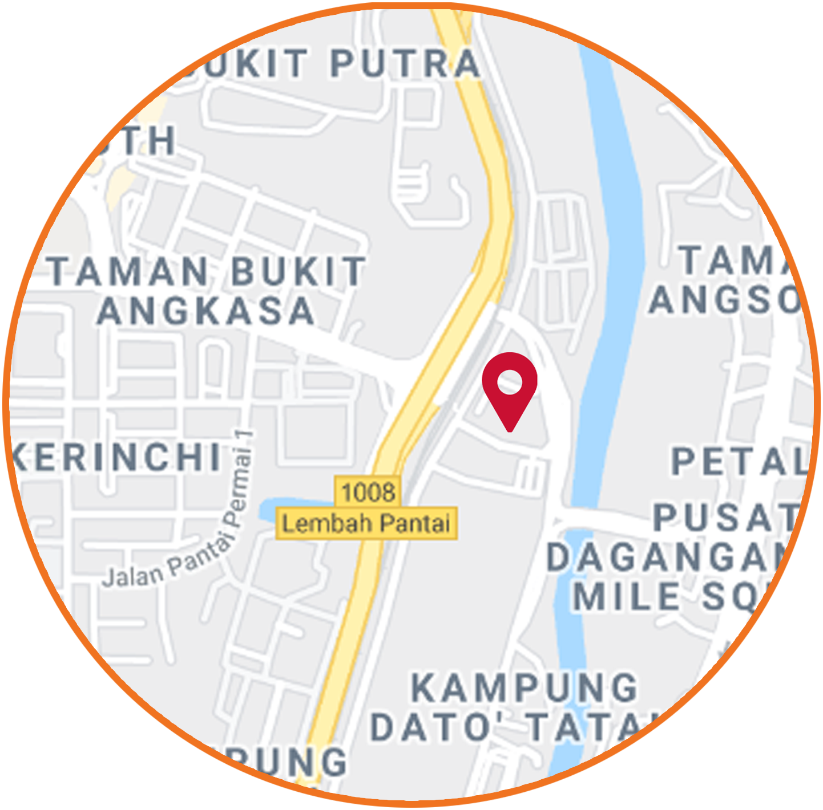
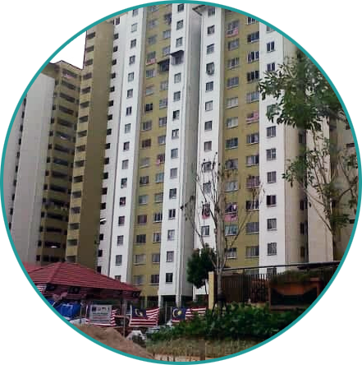
Association between self-perceived stress, anxiety, depression and quality of life in a Malaysian B40 community: a cross-sectional study
School of Medicine, Faculty of Health and Medical Sciences, Taylor’s University, Malaysia
Team 6:
Kishen Kumar (0333155)
Nimesha Tillekeratne (0332178)
Rishan Charles Razali (0323663)
Tilanka Tillekeratne (0332177)
Supervisor:
Dr. Sapna Shridhar Patil
Notes:
Teal R34 G154 B153
Orange R240 G155 B32

Slide 2
Contents
Introduction
Literature review
Methodology
Results
Conclusion
Recommendations
Notes:
Marie Jahoda, in 1958, devised a list of characteristics which are present in the majority of people who are regarded as normal. Known as Ideal Mental Health, these were:
Efficient self perception
Realistic self esteem and acceptance
Voluntary control of behaviour
True perception of the world
Sustaining relationships and giving affection
Self-direction and productivity

Slide 3
Introduction
TOP 20% (T20)
RM 15,301
1.46M
Households
Median Income per month
MIDDLE 40% (M40)
RM 7,093
2.91M
Bottom 40% (B40)
In Malaysia, the bottom 40% (B40) includes low income earners comprising of 2.91 million households and a median income of RM 3,166 per month
Department of Statistics, Malaysia (2019)
BOTTOM 40% (B40)
RM 3,166
2.91M
Notes:
**the mean value of the national PLI is at RM2,208, which is within the bottom 10% of households
Household Income & Basic Amenities Survey Report 2019

Slide 4
Introduction
Quality of Life (QOL)
“An individuals’ perceptions of their position in life in the context of the culture and value systems in which they live, and in relation to their goals, expectations, standards and concern”
WHOQOL Group (1995)
Mental Health
The capacity to realise one’s own abilities, cope with the normal stresses of life, work productively, and make a contribution to their community.
Marie Jahoda (1958)
Notes:
Marie Jahoda, in 1958, devised a list of characteristics which are present in the majority of people who are regarded as normal. Known as Ideal Mental Health, these were: formulated the basic premise of what has come to be known as “positive psychology.” In her masterpiece Current Concepts of Positive Mental Health,
Efficient self perception
Realistic self esteem and acceptance
Voluntary control of behaviour
True perception of the world
Sustaining relationships and giving affection
Self-direction and productivity

Slide 5
Introduction
Research gap
To the best of our knowledge, there are no studies at present on the association between QOL and mental health state in low-income urban populations, in Malaysia.
Notes:
Teal R34 G154 B153
Orange R240 G155 B32

Slide 6
Introduction
Objective
To study the association between self-perceived stress, anxiety, and depression and four domains of QOL (physical health, psychological, social relationships, and environment) in adult residents living in PPR Seri Pantai, a B40 community.
Notes:
Teal R34 G154 B153
Orange R240 G155 B32

Slide 7
Introduction
Significance of this study
To contribute to the body of literature from which evidence based policies can developed to address the socioeconomic and health disparities in the B40 community.
Notes:
to add to the body of literature from which evidence based policies can be drawn from to address the socioeconomic and health disparities in the B40 community

Slide 8
Literature review
Author | Year | Key Findings | Relates to this study | Differences from this study
Isabel Matute et al (study in Chile) | 2017 | The probability of poor health-related quality of life is higher in the worst socioeconomic status strata The probability of poor quality of life was higher in persons with only primary school education and those not working and low income | Effect of sociodemographic factors & socioeconomic status on QOL | Sample size 4473 people Sample >25 years old Uses item short-form Health Survey (SF-12)
Notes:
Teal R34 G154 B153
Orange R240 G155 B32

Slide 9
Literature review
Author | Year | Key Findings | Relates to this study | Differences from this study
Sharifa Ezat Wan Puteh et al. (study in Malaysia) | 2019 | Low QOL associated with males, single, low household income, and present chronic medical illness Poor health status associated with female, lower education level and present chronic medical illness | Bottom 40 population - Malaysian Study Investigates QOL with effect on health Sample >18 years old | Sample size 347 (only 283 valid due to incomplete filling of questionnaires by 64 people) QoL measured by EQ 5D not WHOQOL BREF Health status measured with Visual Analogue Score (VAS) not DAAS
Notes:
Teal R34 G154 B153
Orange R240 G155 B32

Slide 10
Literature review
Author | Year | Key Findings | Relates to this study | Differences from this study
Mohsen Mirzaei et al (Study in Iran) | 2019 | Depression, anxiety and stress are all more prevalent in females as compared to males and are also remarkably higher in the older adult population as compared to the younger adult population | Investigate mental health in adult population and examine associated socioeconomic/demographic status Sample: Older and younger adults DASS used to measure depression, anxiety, stress. | Sample size 10,000 people Focuses on association between sociodemographic/ socioeconomic status and mental health Not specific to low income population
Notes:
Teal R34 G154 B153
Orange R240 G155 B32

Slide 11
Literature review
Author | Year | Key Findings | Relates to this study | Differences from this study
Najmeh Rabanipour et.al (Iran ~ Isfahan Steal company) | 2018 | This study showed a significant association between mental health and Quality of life (People with good mental health status had higher quality of life (P<0.0001)) The results showed that abnormal mental health is the most important factor for low QoL among all studied QoL's determinants. Abnormal mental health (depression, anxiety, stress) causes negative feelings on person’s life which in turn influences the QoL. | Investigates the relationship between mental health and quality of life. . | Sample size of 3,063 industrial employees Quality of life is assessed through EQ-5D Study conducted among industrial employees
Notes:
Teal R34 G154 B153
Orange R240 G155 B32

Slide 12
Literature review
Author | Year | Key Findings | Relates to this study | Differences from this study
Nicoly Machado Maciel et al (study in Brazil) | 2018 | QOL is directly related to SES, in that QOL is higher in families with higher SES. Demographics affect QOL (older age, women for instance associated with low QOL) Most participants were experiencing low QOL, both mentally and physically. | Compares QOL, sociodemographics and mental health | Sample size 600 people Sample >20 years old Uses item short-form Health Survey (SF-36)
Notes:
Teal R34 G154 B153
Orange R240 G155 B32

Slide 13
Literature review
Author | Year | Key Findings | Relates to this study | Differences from this study
Anna Leiler et.al (Sweden ~ Asylum seekers and Refugees) | 2019 | Individual (n=510) whom showed significantly high level of psychological distress and rates their quality of life as low. 56-58.4% of the total sample were having clinically significant mental health issue rated the QOL below normal range. Strongest association was found between the degree of depression and Quality of life. | Association between the psychological distress and quality of life. Quality of life were assessed by WHOQOL-BREF questionnaire. . | Done in among asylum seekers and refugees. Mental health separated into Anxiety, Depression and PTSD. The questionnaires were instead PHQ-9, GAD-7 and PC-PTSD instead of DAS.
Notes:
Teal R34 G154 B153
Orange R240 G155 B32

Slide 14
Methodology
Study design and population
Cross-sectional study among residents in PPR Seri Pantai
Adults (18 years and above)
Sampling and data collection
Sampling frame → apartment blocks 100 & 102
Sampling method → Convenience sampling
Sample size → 107 respondents
Notes:
Almost an equal distribution of respondents from both blocks
Low cost high rise apartments with 21 floors housing 400 households

Slide 15
Methodology
Study instruments
Validated Malay version of the World Health Organization Quality of Life – Brief (WHOQOL-BREF) questionnaire
Validated Malay version of the Depression, Anxiety, Stress Scale – 21 Items (DASS-21)
Notes:
Teal R34 G154 B153
Orange R240 G155 B32

Slide 16
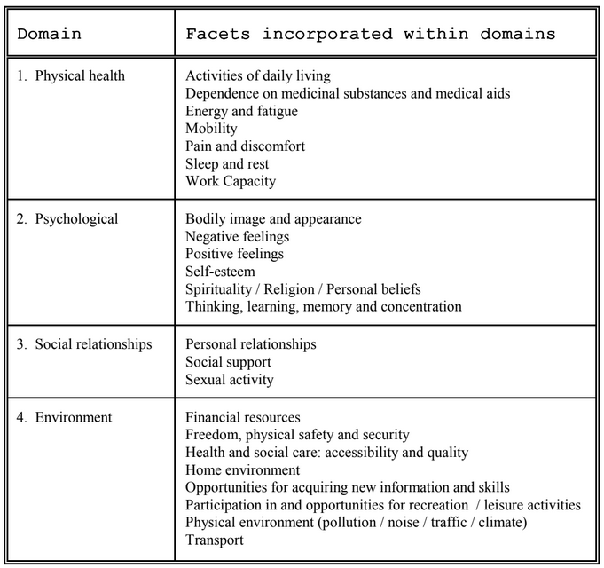
Methodology
WHOQOL-BREF
Comprises 26 items of which 24 items are divided into four domains
All items are rated on a 5 point Likert scale
Total scores transformed to out of 100
Notes:
Likert scale from 0 = not at all to 5 = an extreme amount 3 = moderate amount

Slide 17
Methodology
DASS-21
Comprises 21 items equally divided across three mental subscales
Add scores for the 7 items and multiply by 2
Categorize the scores based on the table values
Depression: Q3, 5, 10, 13, 16, 17, 21
Anxiety: Q2, 4, 7, 9, 15, 19, 20
Stress: Q1, 6, 8, 11, 12, 14,18
 | Depression | Anxiety | Stress
Normal | 0-9 | 0-7 | 0-14
Mild | 10-13 | 8-9 | 15-18
Moderate | 14-20 | 10-14 | 19-25
Severe | 21-27 | 15-19 | 26-33
Extremely Severe | 28+ | 20+ | 34+
Notes:
Over the past week
0 = Did not apply to me at all
3 = Applied to me very much, or most of the time (almost always)

Slide 18
Results
Table 1: Distribution of sociodemographic characteristics (n = 107)
Characteristics | n (%)
Age
18-30 | 17 (15.9)
31-60 | 82 (76.6)
≥ 61 | 8 (7.5)
Sex
Male | 17 (15.9)
Female | 90 (84.1)
Ethnicity
Malay | 93 (86.9)
Indian | 14 (13.1)
Characteristics | n (%)
Marital Status
Married | 64 (59.8)
Unmarried | 22 (20.6)
Once Married | 21 (19.6)
Education
Primary | 11 (10.3)
Secondary | 80 (74.8)
Tertiary | 16 (15.0)
Employment
Employed | 51 (47.7)
Unemployed | 56 (52.3)

Slide 19
Results
Table 2: Distribution of mean scores of the DASS-21 subscales and WHOQOL-BREF domains
Characteristics | No. of Items | Mean ± SD
DASS-21
Stress | 7 | 11.215 ± 9.069
Anxiety | 7 | 9.664 ± 9.018
Depression | 7 | 9.038 ± 9.526
WHOQOL-BREF
Physical health | 7 | 67.18 ± 16.34
Psychological | 6 | 62.71 ± 13.43
Social Relationships | 3 | 64.55 ± 21.39
Environment | 8 | 64.60 ± 15.87
General QOL | 1 | 3.84 ± .89
General Health | 1 | 3.55 ± 1.11
Notes:
DASS-21 mean scores
Normal stress levels
Normal depression levels
Mild anxiety levels
WHOQOL-BREF mean scores
Physical health was highest
Psychological was lowest
Looking at the distribution of scores

Slide 20
Results
Table 3: Correlations between WHOQOL-BREF domains and the DASS-21 subscales
WHOQOL-BREF | DASS-21
 | Stress | Anxiety | Depression
Physical Health | -.334** | -.364** | -.342**
Psychological | -.319** | -.273** | -.286**
Social Relationships | -.496** | -.434** | -.434**
Environment | -.271** | -.209* | -.188
General QOL | -.265** | -.255** | -.240*
General Health | -.230* | -.308** | -.286**
* correlation is significant at the 0.05 level
** correlation is significant at the 0.01 level
Notes:
Multiple Pearson's correlation was run to assess the relationship between the WHOQOL-BREF domains and DASS-21 subscales in the sample population.
Preliminary analyses showed the relationship to be linear with physical health and psychological health the only variables which were normally distributed, as assessed by Shapiro-Wilk's test (p > .05). There were two outliers in the anxiety scores and one outlier in the depression score.
Statistically significant, negative correlation
Strongest correlation between social relationships and three subscales of mental health
There was statistically significant, moderate negative correlation between the four QOL domains and three DASS-21 mental health subscales, except for between environment and depression which was not statistically significant (p > .05).
There was statistically significant but weak negative correlation between General QOL and all three DASS-21 subscales, stress (r= -.265, p < .01), anxiety (r= -.255, p < .01), and depression (r= -.240, p < .05).

Slide 21
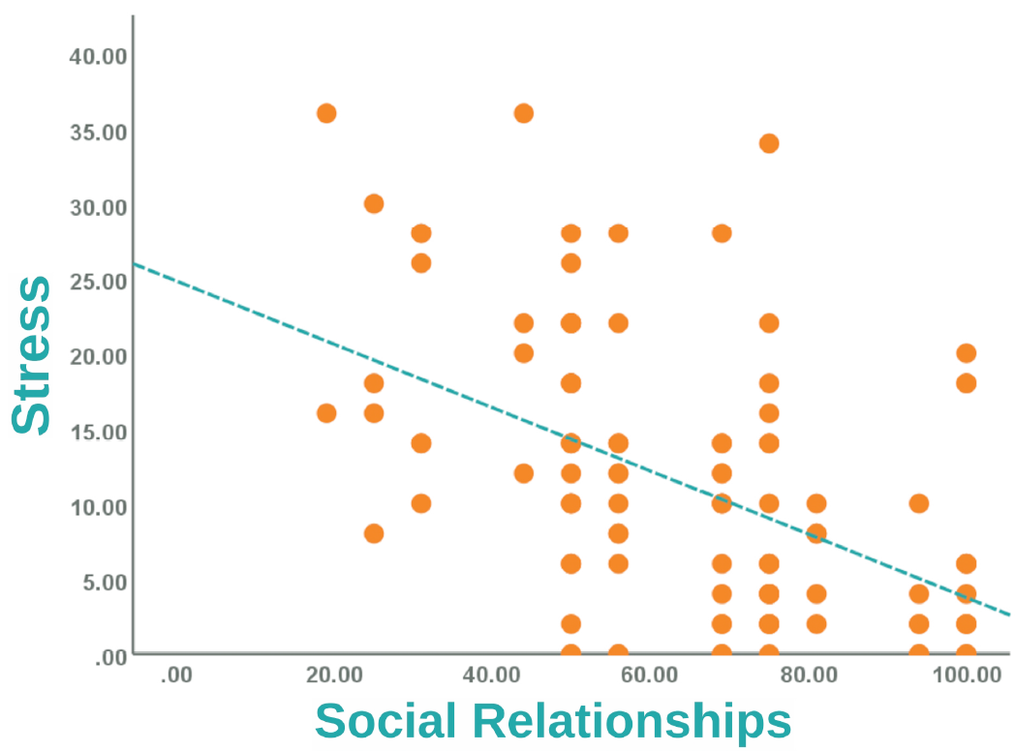
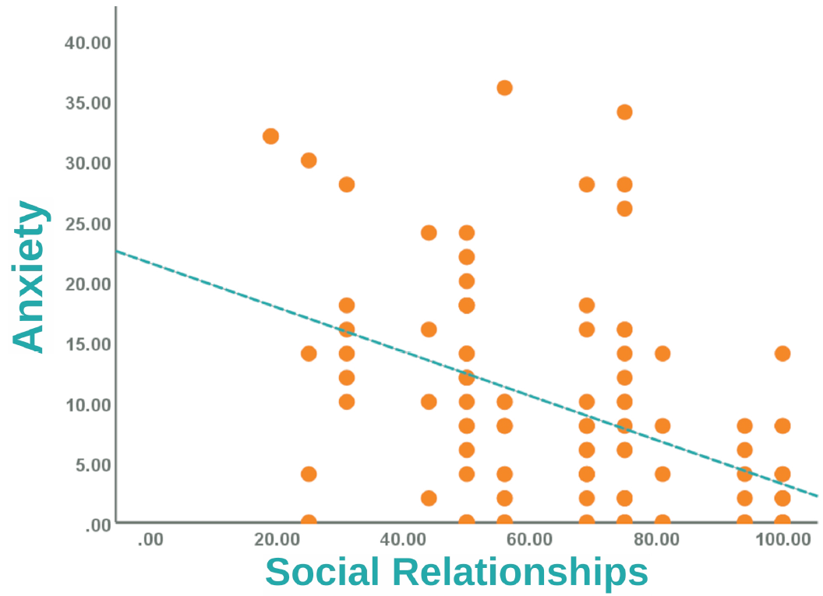
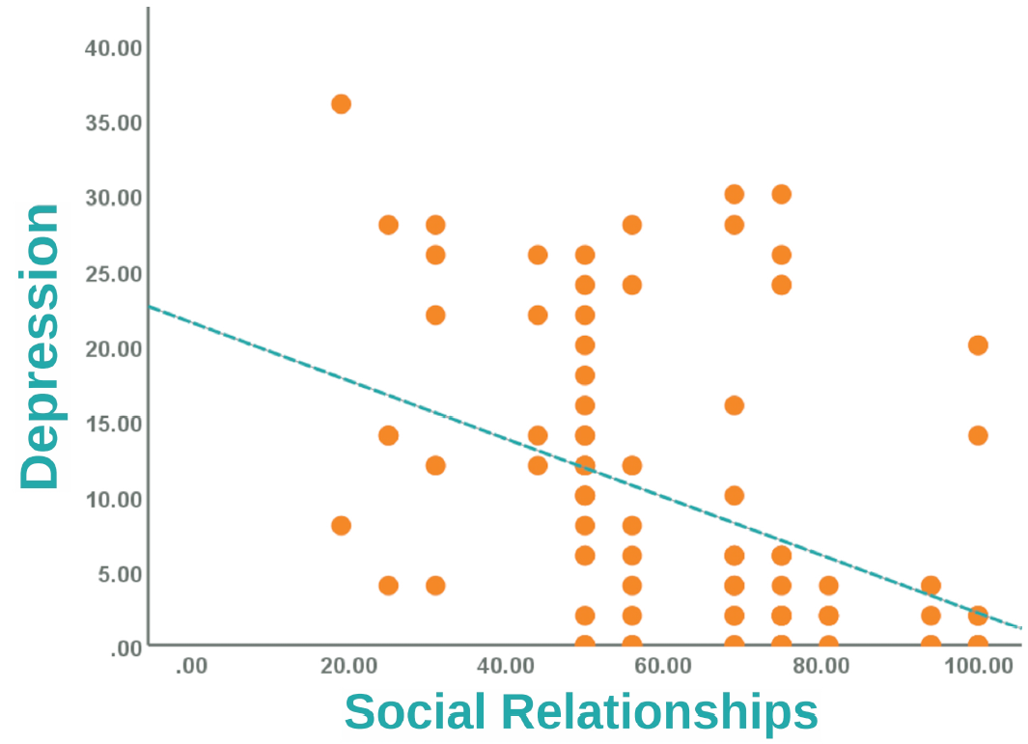
Results
Figure 1: Scatter plot of the correlation between social relationships domain and subscales of DASS-21
Notes:
Multiple Pearson's correlation was run to assess the relationship between the WHOQOL-BREF domains and DASS-21 subscales in the sample population.
Preliminary analyses showed the relationship to be linear with physical health and psychological health the only variables which were normally distributed, as assessed by Shapiro-Wilk's test (p > .05). There were two outliers in the anxiety scores and one outlier in the depression score.
There was statistically significant, moderate negative correlation between the four QOL domains and three DASS-21 mental health subscales, except for between environment and depression which was not statistically significant (p > .05).
There was statistically significant but weak negative correlation between General QOL and all three DASS-21 subscales, stress (r= -.265, p < .01), anxiety (r= -.255, p < .01), and depression (r= -.240, p < .05).

Slide 22
Limitations
Cross-sectional nature
Relatively small sample size (n=107)
Use of convenience sampling

Slide 23
Conclusion
An inverse relationship between QOL and mental health subscales was identified
Of the four QOL domains, social relationships had the strongest negative correlation with stress, anxiety, and depression.
Notes:
Social relationships

Slide 24
Recommendations
Further in-depth studies to be conducted to determine a causal relationship between QOL and mental health
To develop evidence based policies in addressing the socioeconomic and health disparities in the B40 community so that “no one will be left behind”
Notes:
Based on the correlational findings, we recommend that further studies be conducted to determine the causal relationship between these mental health subscales and the domains of QOL.
With an increasing supportive body of evidence, key areas in QOL and mental health can be identified to maximize the efficacy of policy initiatives with the aim of reducing health and socioeconomic disparities in the B40 community.

Slide 25
References
1. WHO. World Health Organization (1996) WHO-BREF: Introduction, administration, scoring and generic version of the assessment. 1996.
2. Wan Puteh SE, Siwar C, Zaidi MAS, Abdul Kadir H. Health related quality of life (HRQOL) among low socioeconomic population in Malaysia. BMC Public Health. 2019;19(Suppl 4):4–11.
3. Gobbens RJJ, Remmen R. The effects of sociodemographic factors on quality of life among people aged 50 years or older are not unequivocal: Comparing SF-12, WHOQOL-BREF, and WHOQOL-OLD. Clin Interv Aging. 2019;14:231–9.
4. Feng X, Astell-Burt T. Impact of a type 2 diabetes diagnosis on mental health, quality of life, and social contacts: A longitudinal study. BMJ Open Diabetes Res Care. 2017;5(1):1–5.
5. Wong FY, Yang L, Yuen JWM, Chang KKP, Wong FKY. Assessing quality of life using WHOQOL-BREF: A cross-sectional study on the association between quality of life and neighborhood environmental satisfaction, and the mediating effect of health-related behaviors. BMC Public Health. 2018;18(1):1–14.
6. Dubay LC, Lebrun LA. Health, behavior, and health care disparities: Disentangling the effects of income and race in the United States. Int J Heal Serv. 2012;42(4):607–25.
7. Jahoda M. Current concepts of positive mental health. Basic Books; 1958.
8. Saarni SI, Suvisaari J, Sintonen H, Pirkola S, Koskinen S, Aromaa A, et al. Impact of psychiatric disorders on health-related quality of life: General population survey. Br J Psychiatry. 2007;190(APR.):326–32.
9. Whiteford HA, Ferrari AJ, Degenhardt L, Feigin V, Vos T. The global burden of mental, neurological and substance use disorders: An analysis from the global burden of disease study 2010. PLoS One. 2015;10(2):1–15.
10. Walker E, McGee R, Druss B. Mortality in mental disorders and global disease burden implications: a systematic review and meta-analysis. JAMA Psychiatry. 2015;72(4):334–41.
11. Cho Y, Lee J, Kim D, Park J, Choi M, Kim H. Factors associated with quality of life in patients with depression: A nationwide population-based study. PLoS One. 2019;14(7).
12. Rabbanipour N, Roohafza H, Feizi A, Rabey K, Sarrafzadegan N. The association between sleep duration and quality of life: A crosssectional study in a large sample of Isfahan steal company’s employees. Iran Occup Heal. 2018;15(3):31–44.
13. Tang AL, Thomas SJ. Relationships Between Depressive Symptoms, Other Psychological Symptoms, and Quality of Life. Psychiatry Res [Internet]. 2020;289(October 2019):113049. Available from: https://doi.org/10.1016/j.psychres.2020.113049
Notes:
Teal R34 G154 B153
Orange R240 G155 B32

Slide 26
References
14. Raknes S, Pallesen S, Himle JA, Bjaastad JF, Wergeland GJ, Hoffart A, et al. Quality of life in anxious adolescents. Child Adolesc Psychiatry Ment Health. 2017;11(1):1–12.
15. Leiler A, Bjärtå A, Ekdahl J, Wasteson E. Mental health and quality of life among asylum seekers and refugees living in refugee housing facilities in Sweden. Soc Psychiatry Psychiatr Epidemiol. 2019;54(5):543–51.
16. Baker E. Socioeconomic Status, Definition. The Wiley Blackwell Encyclopedia of Health, Illness, Behavior, and Society. 2014.
17. Cho Y, Lee J, Kim D, Park J, Choi M, Kim H, et al. Factors associated with quality of life in patients with depression: A nationwide population-based study. PLoS One [Internet]. 2019;14(7):1–12. Available from: https://doi.org/10.1016/j.psychres.2020.113049
18. Mirzaei M, Ardekani SMY, Mirzaei M, Dehghani A. Prevalence of depression, anxiety and stress among adult population: Results of yazd health study. Iran J Psychiatry. 2019;14(2):137–46.
19. Dahmann SC. The protective (?) effect of Education on Mental Health. Berlin; 2017.
20. Sunde M. Examining the relationship between socioeconomic status and mental health quality of life in a rural neighborhood context. University of Iowa; 2016.
21. Kerebih H, Soboka M. Prevalence of Common Mental Disorders and Associated Factors among Residents of Jimma Town, South West Ethiopia. J Psychiatry. 2016;19(4).
22. Maciel NM, De Conti MHS, Simeão SFAP, Genebra CVDS, Corrente JE, De Vitta A. Sociodemographic factors, level of physical activity and health-related quality of life in adults from the north-east of São Paulo, Brazil: A cross-sectional population study. BMJ Open. 2018;8(1):1–11.
23. Lodhi FS, Montazeri A, Nedjat S, Mahmoodi M, Farooq U, Yaseri M, et al. Assessing the quality of life among Pakistani general population and their associated factors by using the World Health Organization’s quality of life instrument (WHOQOL-BREF): A population based cross-sectional study. Health Qual Life Outcomes. 2019;17(1).
24. Rusli BN, Edimansyah BA, Naing L. Working conditions, self-perceived stress, anxiety, depression and quality of life: A structural equation modelling approach. BMC Public Health. 2008;8:1–12.
25. Eleventh Malaysia Plan [Internet]. Economic Planning Unit, Malaysia. 2015. p. 372. Available from: https://www.pmo.gov.my/dokumenattached/speech/files/RMK11_Speech.pdf
26. Household Income & Basic Amenities Survey Report 2019 [Internet]. Department of Statistics, Malaysia. 2019 [cited 2020 Jul 29]. Available from: https://www.dosm.gov.my/v1/index.php?r=column/cthemeByCat&cat=120&bul_id=TU00TmRhQ1N5TUxHVWN0T2VjbXJYZz09&menu_id=amVoWU54UTl0a21NWmdhMjFMMWcyZz09
Notes:
Teal R34 G154 B153
Orange R240 G155 B32

Slide 27
References
27. Kim JH, Park EC. Impact of socioeconomic status and subjective social class on overall and health-related quality of life. BMC Public Health [Internet]. 2015;15(1). Available from: http://dx.doi.org/10.1186/s12889-015-2014-9
28. Menati W, Baghbanian A, Asadi-Lari M, Moazen J, Menati R, Sohrabivafa M, et al. Health-related quality of life and socioeconomic status: Inequalities among adults in west of Iran. Iran Red Crescent Med J. 2017;19(7).
29. Sareen J, Afifi TO, McMillan KA, Asmundson GJG. Relationship Between Household Income and Mental Disorders. Arch Gen Psychiatry. 2011;68(4):419.
30. Ibrahim N, Amit N, Shahar S, Wee LH, Ismail R, Khairuddin R, et al. Do depression literacy, mental illness beliefs and stigma influence mental health help-seeking attitude? A cross-sectional study of secondary school and university students from B40 households in Malaysia. BMC Public Health. 2019;19(Suppl 4):1–9.
31. McLaughlin KA, Costello EJ, Leblanc W, Sampson NA, Kessler RC. Socioeconomic status and adolescent mental disorders. Vol. 102, American Journal of Public Health. 2012. p. 1742–50.
32. Program perumahan rakyat(PPR) [Internet]. Official Portal National Housing Department, Malaysia. 2015 [cited 2020 Aug 6]. Available from: https://ehome.kpkt.gov.my/index.php/pages/view/133
33. Hasanah C, Naing L, Rahman A. World Health Organization quality of life assessment: brief version of Bahasa Malaysia. Med J Malaysia. 2003;58(1):79–88.
34. Admin E Bin, Nordin R Bin, Lin N, Abdullah MR Bin, Than W. Reliability and concurrent validity of the Malay version of Depression Anxiety Stress Scale (DASS) in automotive assembly workers in Malaysia. Ind Heal. 2007;45(3):437–48.
35. Nur Azma B, Rusli B, Quek K, Noah RM. Psychometric properties of the Malay version of the Depression Anxiety Stress Scale-21 ( M-DASS21 ) among nurses in public hospitals in the Klang Valley. Int J Collab Res Intern Med Public Heal. 2014;6(5):109–20.
36. Nordin R Bin, Kaur A, Soni T, Por LK, Miranda S. Construct validity and internal consistency reliability of the malay version of the 21-item depression anxiety stress scale (Malay-DASS-21) among male outpatient clinic attendees in Johor. Med J Malaysia. 2017;72(5):264–70.
37. Kassani A, Asadi-Lari M, Hassanzadeh J. Assessment of quality of life among residents of Tehran: Results from a large cross sectional study. Iran J Public Health. 2016;45(3):403–4.
38. Bilgili N, Arpaci F. Quality of life of older adults in Turkey. Arch Gerontol Geriatr [Internet]. 2014;59(2):415–21. Available from: http://dx.doi.org/10.1016/j.archger.2014.07.005
39. Soósová MS. Determinants of quality of life in the elderly. Cent Eur J Nurs Midwifery [Internet]. 2016;7(3):484–93. Available from: https://doi.org/10.15452/CEJNM.2016.07.0019
40. Bauldry S. Variation in the Protective Effect of Higher Education Against Depression. Soc Ment Heal. 2015;5(2):145–61.
41. Blay SL, Marchesoni MSM. Association among physical, psychiatric and socioeconomic conditions and WHOQOL-Bref scores. Cad Saude Publica. 2011;27(4):677–86.
Notes:
Teal R34 G154 B153
Orange R240 G155 B32

