Slide 1
Knowledge, Attitude, and Practice Towards COVID-19 Among Student Nurses in Metro Manila, Philippines: A Cross-Sectional Study
Authors:
Earl Zedrick S. Quisao
Raven Rose R. Tayaba
Gil P. Soriano, MHPEd, RN

Slide 2
INTRODUCTION
According to experts, a major factor why COVID-19 cases persist to increase is due to faulty human behavior (Lee, 2020; Maragakis, 2020)
On October 25, 2020, Manila Bulletin released an article announcing that over 100, 000 quarantine violators were arrested by the Philippine National Police (Chavez, 2020).
A study revealed that public knowledge is vital in response to outbreaks (University of Surrey, 2018)

Slide 3
As early as in their 2nd year in the nursing program, student nurses are taught how to educate people in the community. Assessing their current awareness and knowledge about this virus and its prevention can identify gaps that affect their perceptions and responses which they can integrate into those people in the community.
Thus, this study aims to investigate the KAP towards COVID-19 of Student Nurses in Metro Manila during this pandemic.

Slide 4
OBJECTIVES
This study aims to:
Determine the demographic profile of the student nurses’
Assess the level of knowledge, attitude and practice of student nurses’ about COVID-19
Evaluate the association of the demographic profiles with the level of knowledge, attitude, and practice about COVID-19.

Slide 5
THEORETICAL FRAMEWORK
Adaptation Model of Nursing by Sister Callista Roy (1976)

Slide 6
CONCEPTUAL FRAMEWORK
INDEPENDENT VARIABLES
DEPENDENT VARIABLES
Social Demographic Profile
Age
Sex
Year level
Family income
Religion
KNOWLEDGE
ATTITUDE
PRACTICE

Slide 7
METHODOLOGY
Research Design/Approach
This study utilized a descriptive cross-sectional survey.
Sampling Technique
Purposive Sampling Technique

Slide 8
METHODOLOGY
Population of the Study
A total of 314 individuals participated in this study.
The participants were nursing students (18 years old and above), studying in a college or a university (either public or private) inside Metro Manila.
Currently enrolled in academic year 2020-2021.
Had access to internet connection and understands the English language.

Slide 9
METHODOLOGY
Setting of the Study
Having the Philippines coined as the social media capital of the world (Sanchez, 2020), the researchers took this as an advantage in spreading their reach in their target participants. The link of the questionnaire was sent through emails, Facebook Messenger, and other social media.

Slide 10
METHODOLOGY
Research Instrument
4 sets of Questionnaire
First Part - Respondent’s information
Second Part - Questionnaire on COVID-19 Knowledge
Third Part - Attitude statement regarding COVID-19
Fourth Part - Practices related to COVID-19
Method of Data Analysis
This study used frequency, percentage, mean, standard deviation, independent t-test, and one-way ANOVA to be able to analyze the data gathered from the selected participants.

Slide 11
METHODOLOGY
Ethical Consideration
The study was approved by San Beda University - Research Ethics Board with Protocol Number 2020-040.

Slide 12
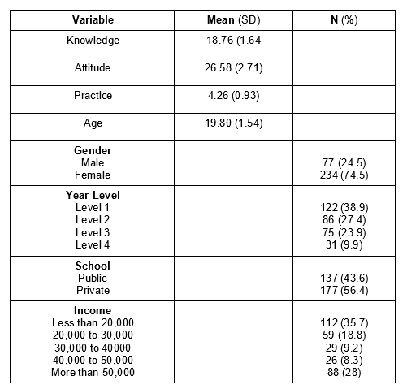
RESULTS
Table 1. Characteristics of the Participants (n=314)

Slide 13
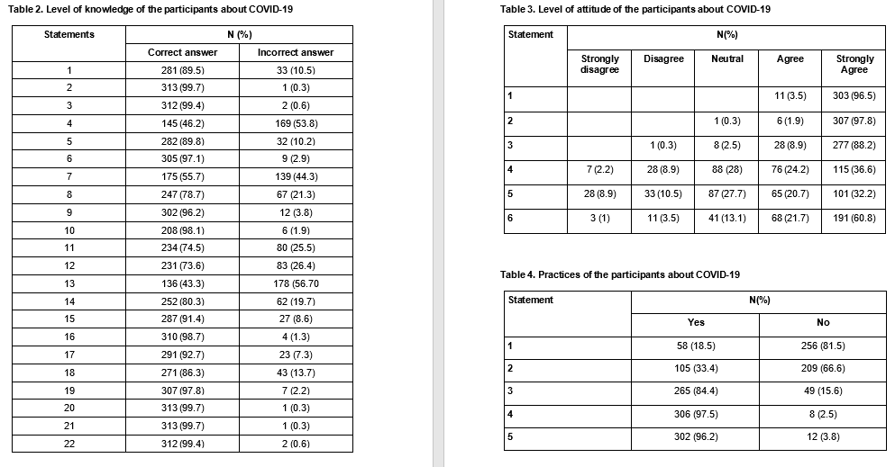
RESULTS

Slide 14
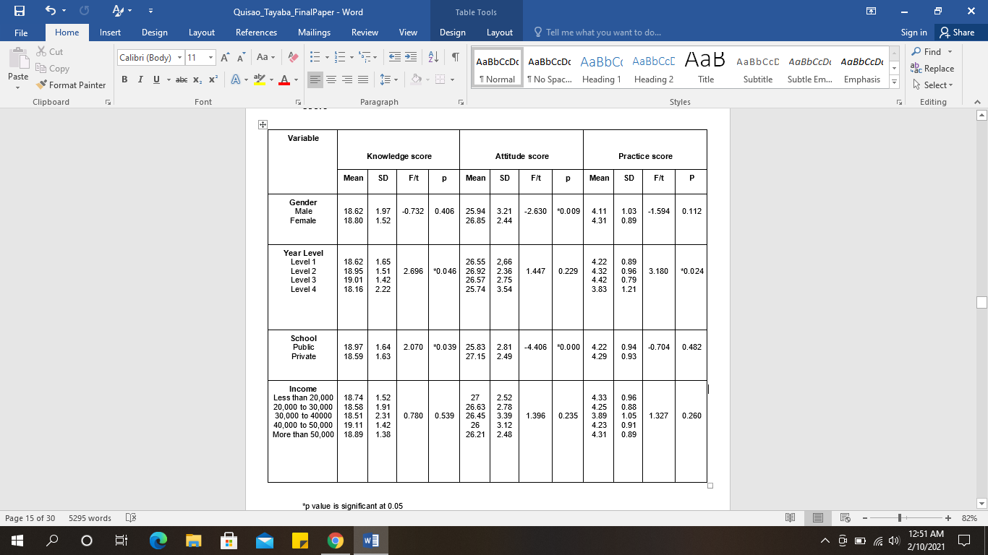
RESULTS and DISCUSSION
Table 5. Comparison of the characteristics of the participants and mean KAP score

Slide 15
CONCLUSION
The study was able to lay out an extensive exploration concerning the knowledge, attitude, and practice towards COVID-19 of student nurses in the Philippines. The outcome proves that Filipino student nurses have a justifiable level of knowledge in the said disease, and are mainly optimistic in their perspective in controlling the pandemic. Nevertheless, having constant reminder from the authorities and health care professionals are the solution to aid public knowledge and comprehension relating to COVID-19.

Slide 16
LIMITATIONS AND RECOMMENDATIONS
As part of the strict measures implemented by the government to combat this Covid19 pandemic, face to face classes were suspended making the education department shift to online classes. This limited the authors to conduct the survey in a larger scale and narrowed the scope to nursing students only. Also due to the constraint, the authors were only able to reach students in 2 different schools in Metro Manila and only those who have reliable internet connection. It is recommended that further research should involve more participants from different regions throughout the country. Moreover, It is also advised to use more extensive methods of data analysis to further correlate the relationships of the different variables in order to fully understand the effects and impacts between these variables.

Slide 17
REFERENCES
Chavez, C. (2020, October 25). 124,576 quarantine violators freed; 1,751 remain detained – DILG. Manila Bulletin. https://mb.com.ph/2020/10/25/124576-quarantine-violators-freed-1751-remain-detained-dilg/
Lee, B. (2020). Why Are Covid-19 Cases Increasing? Here Are 7 Reasons. Forbes. https://www.forbes.com/sites/brucelee/2020/11/23/why-are-covid-19-coronavirus-cases-increasing-here-are-7-reasons/sh=2f35e88d4aa8&fbclid=IwAR2HVe5JbK-BSaNKLDee7e5vTXXbwPOoUB6NGketxUTziyD1SHf-w4o9xZQ
Maragakis, L. (2020). Coronavirus Second Wave? Why Cases Increase. Johns Hopkins Medicine. Retrieved November 30, 2020, from:https://www.hopkinsmedicine.org/health/conditions-and-diseases/coronavirus/first-and-second-waves-of-coronavirus
University of Surrey. (2018). Increasing public awareness is vital in the fight against infectious diseases. ScienceDaily. https://www.sciencedaily.com/releases/2018/01/180129104653.htm
Sanchez, M. (2020). Number of Social Network Users in the Philippines from 2017 to 2019 with a Forecast until 2025. Statista. https://www.statista.com/statistics/489180/number-of-social-network-users-in-philippines/

