Slide 1

Systematic Review on the Incidence of Acute Ischemic Stroke (AIS) in COVID-19 Patients: An Urgent Need for Early Management

Slide 2

Our Team
Dr Mohammed Jaweed
Dollicia Toh
Shannen Kay Chan
Alantino Raven Daniel
Esther Sim Wan Rong
Dr Mohammad Ajmal Yasin
School of Medicine, Taylor’s University and Department of Neurosurgery, Hospital Sungai Buloh
3rd Year Medical Student, School of Medicine, Taylor’s University
3rd Year Medical Student, School of Medicine, Taylor’s University
3rd Year Medical Student, School of Medicine, Taylor’s University
3rd Year Medical Student, School of Medicine, Taylor’s University
Jamaica Hospital Medical Centre, New York

Slide 3


INTRODUCTION
COVID-19 is an infectious disease and an ongoing pandemic caused by the recently found virus known as SARS-CoV-2 (or coronavirus).
It was initially reported to the WHO on December 31, 2019 and was declared a global pandemic on March 11, 2020.

Slide 4
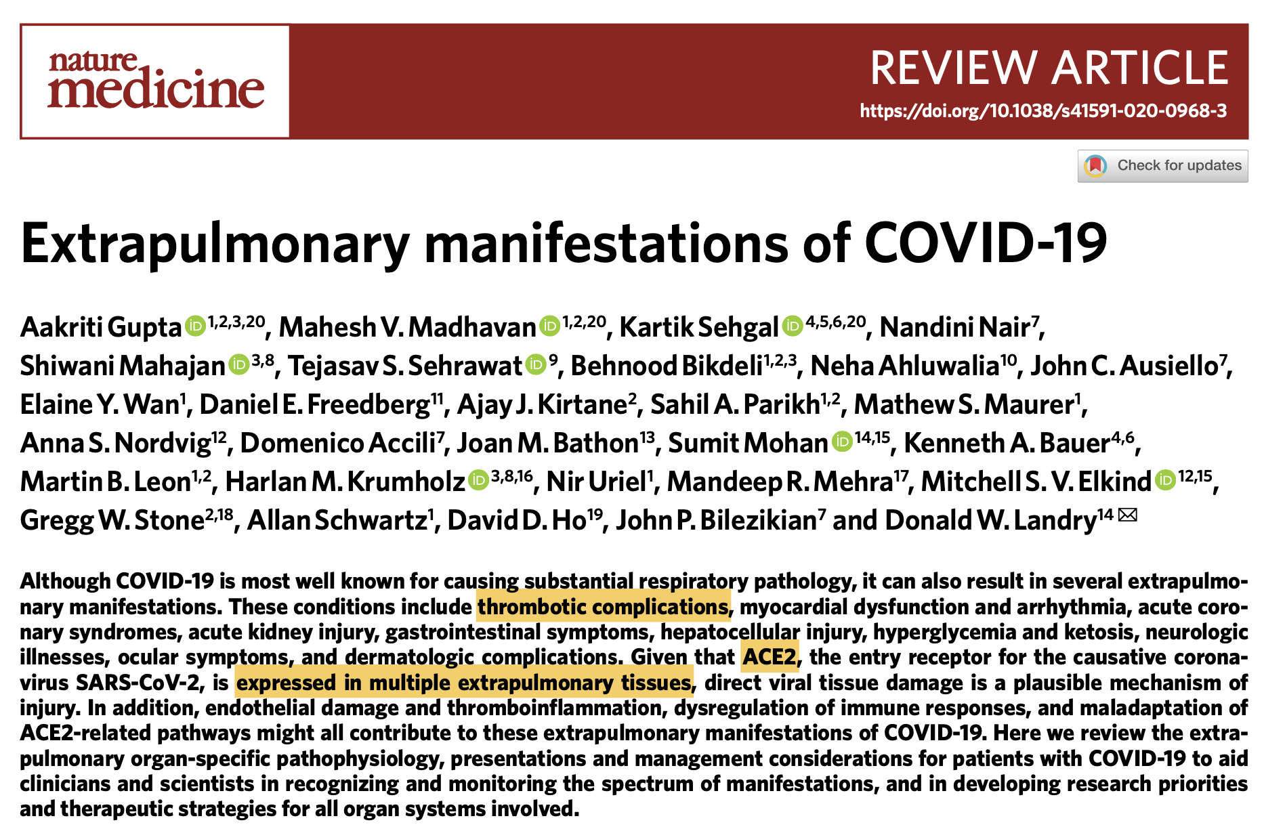
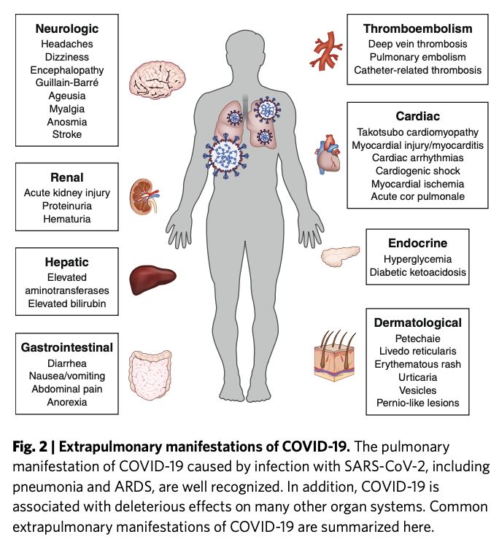

Slide 5
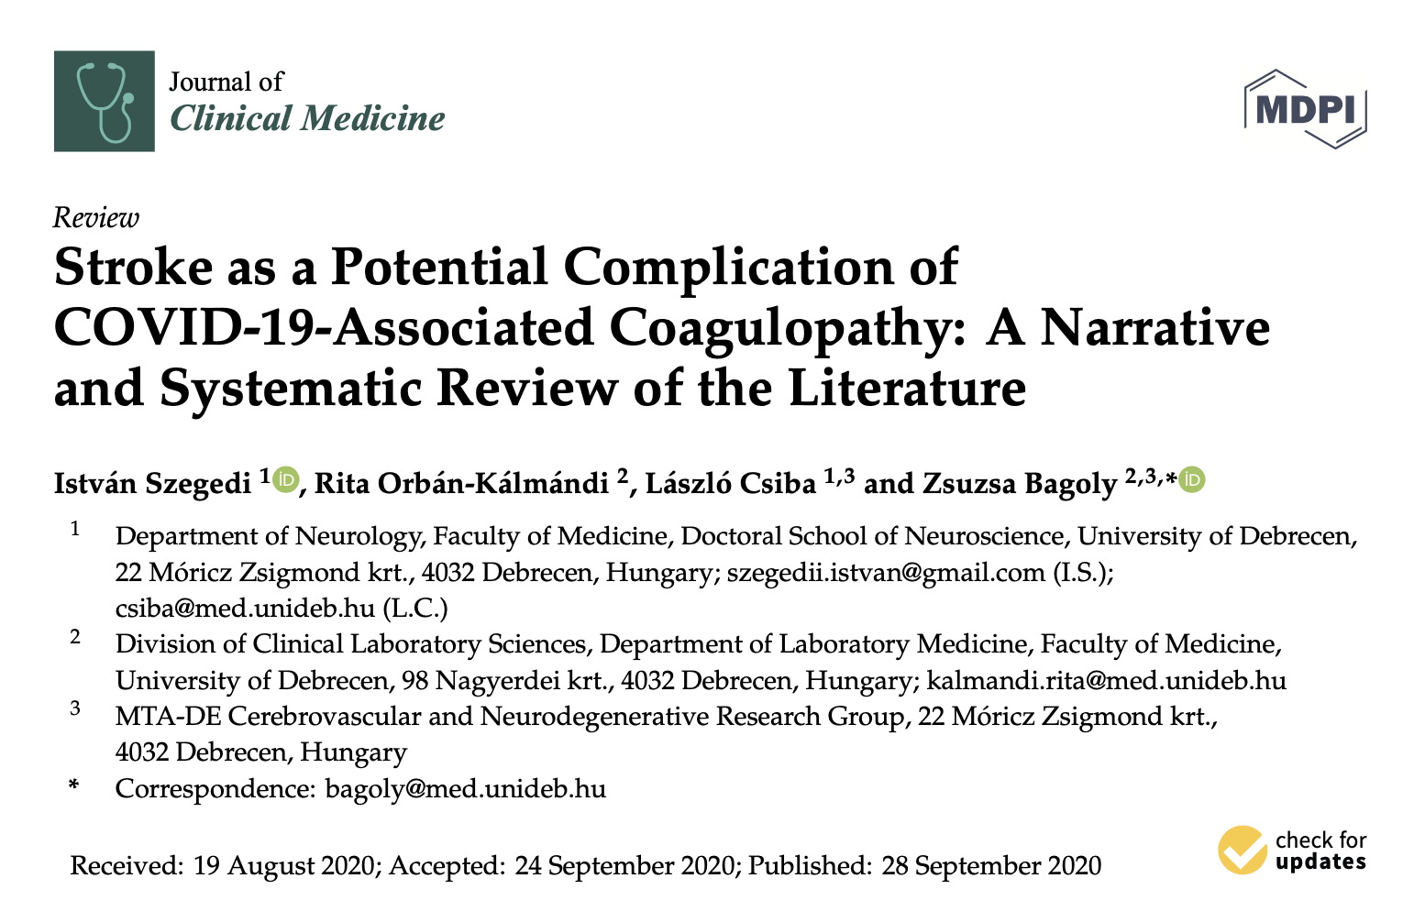
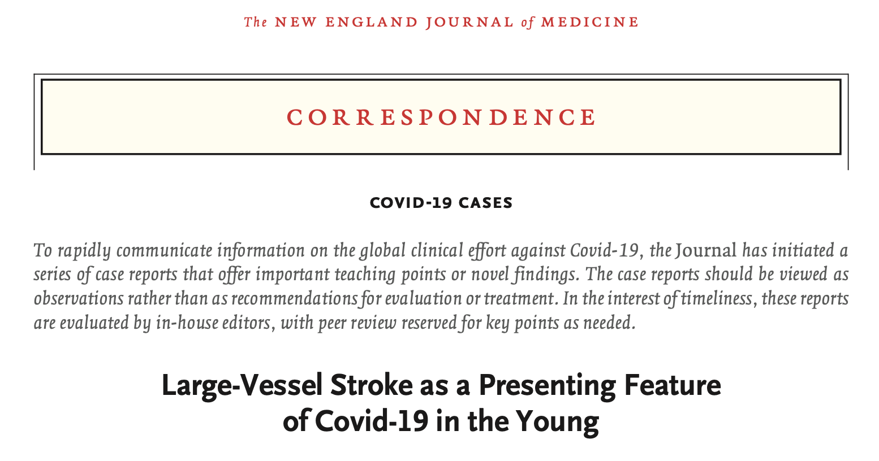
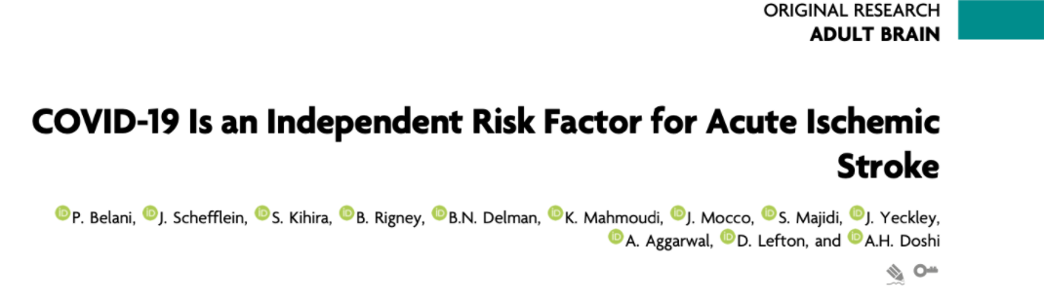

Slide 6
OBJECTIVES OF THE PAPER
ASSOCIATION
DATA & STATISTICS
MANAGEMENT
Link between COVID-19 and acute ischemic stroke (AIS)
Incidence, clinical characteristics of patients, vessels involved, laboratory findings, outcome
In accordance with recommendations and guidelines by international societies

Slide 7
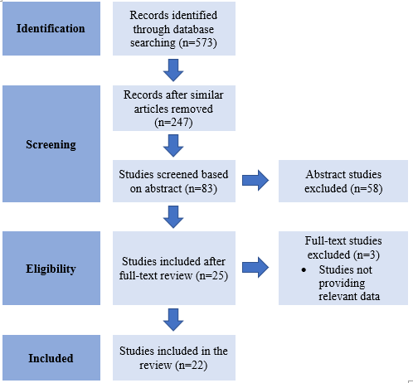
Data Extraction
• Literature search performed in PubMed, Cochrane library and EMBASE from the 1st October 2020 to 1st January 2021
• Keywords: COVID-19; acute ischemic stroke; systematic review; thrombosis; acute cerebrovascular disease
PRISMA Flow Diagram

Slide 8
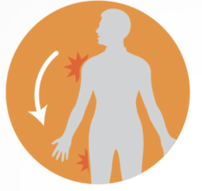


FINDINGS
NO OF PARTICIPANTS
INCIDENCE (%)
MORTALITY (%)
140,903
0.9 - 5.0
COVID
29.20 - 64.00
infected people
Stroke
78.8 - 96.6
AIS
Non-COVID
8.70 - 23.00
MOST COMMON PRESENTING SYMPTOMS OF STROKE IN COVID-19 PATIENTS
UNILATERAL WEAKNESS
ALTERED MENTAL STATUS
DYSARTHRIA

Slide 9
PATIENT DETAILS AND DEMOGRAPHICS
AGE | 61.60 - 76.05 years
GENDER | Male (52.60% - 77.40%)
COMORBIDITIES | Hypertension (42.00% - 84.20%), Diabetes Mellitus (23.20% - 45.32%), Hyperlipidaemia (17.00% - 56.30%)
NIHSS SCORE | 9.79 - 21.50
DAY 1
DAY 7 - 16
Onset of COVID-19 symptoms
Onset / diagnosis of stroke

Slide 10
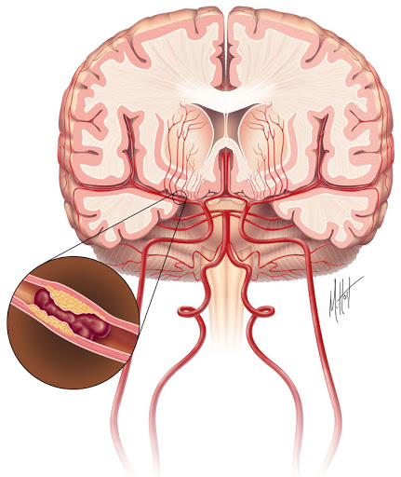
VESSELS INVOLVED
LOCATION
ETIOLOGY (TOAST Classification)
Middle Cerebral Artery 30.50% - 76.60%
Large vessel occlusion 35.20% - 79.60%
Cryptogenic 28.90% - 65.60%
Cardioembolic 14.10% - 42.00%
Small vessel occlusion 2.46% - 20.00%
Internal Carotid Artery 18.30% - 23.00%
Vertebrobasilar Arteries 7.30% - 18.10%
Posterior Cerebral Artery 6.00% - 12.80%
Anterior circulation (unihemispheric) 48.70% - 65.00%
Multiple vascular territories 26.20% - 30.90%

Slide 11
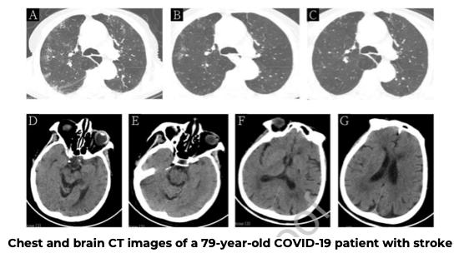
IMAGING

Slide 12
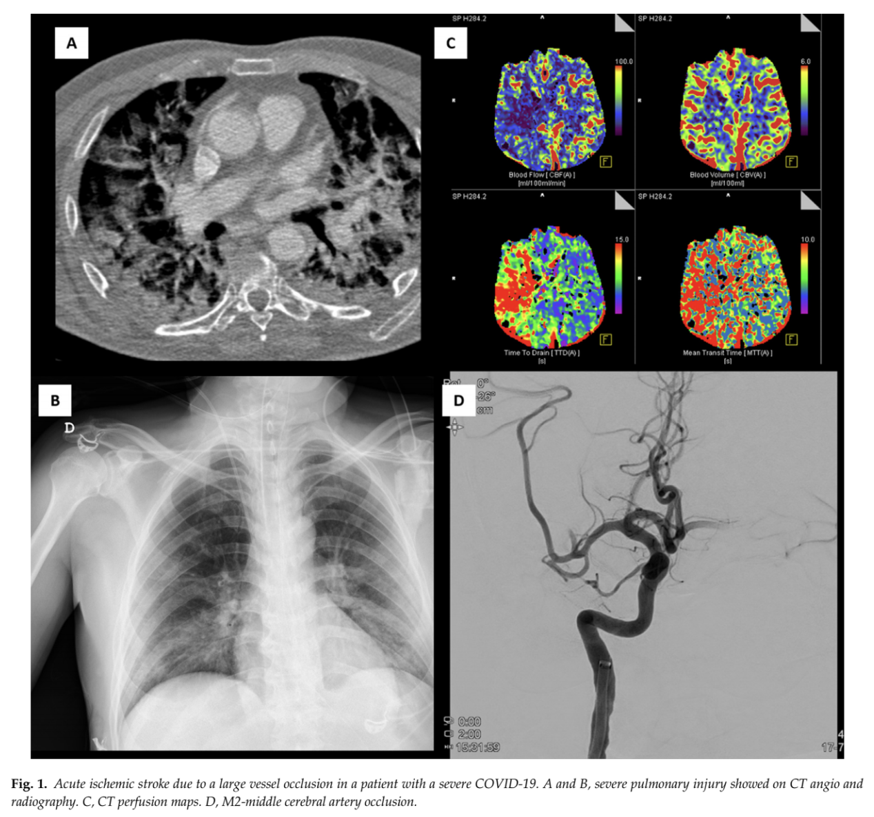

Slide 13
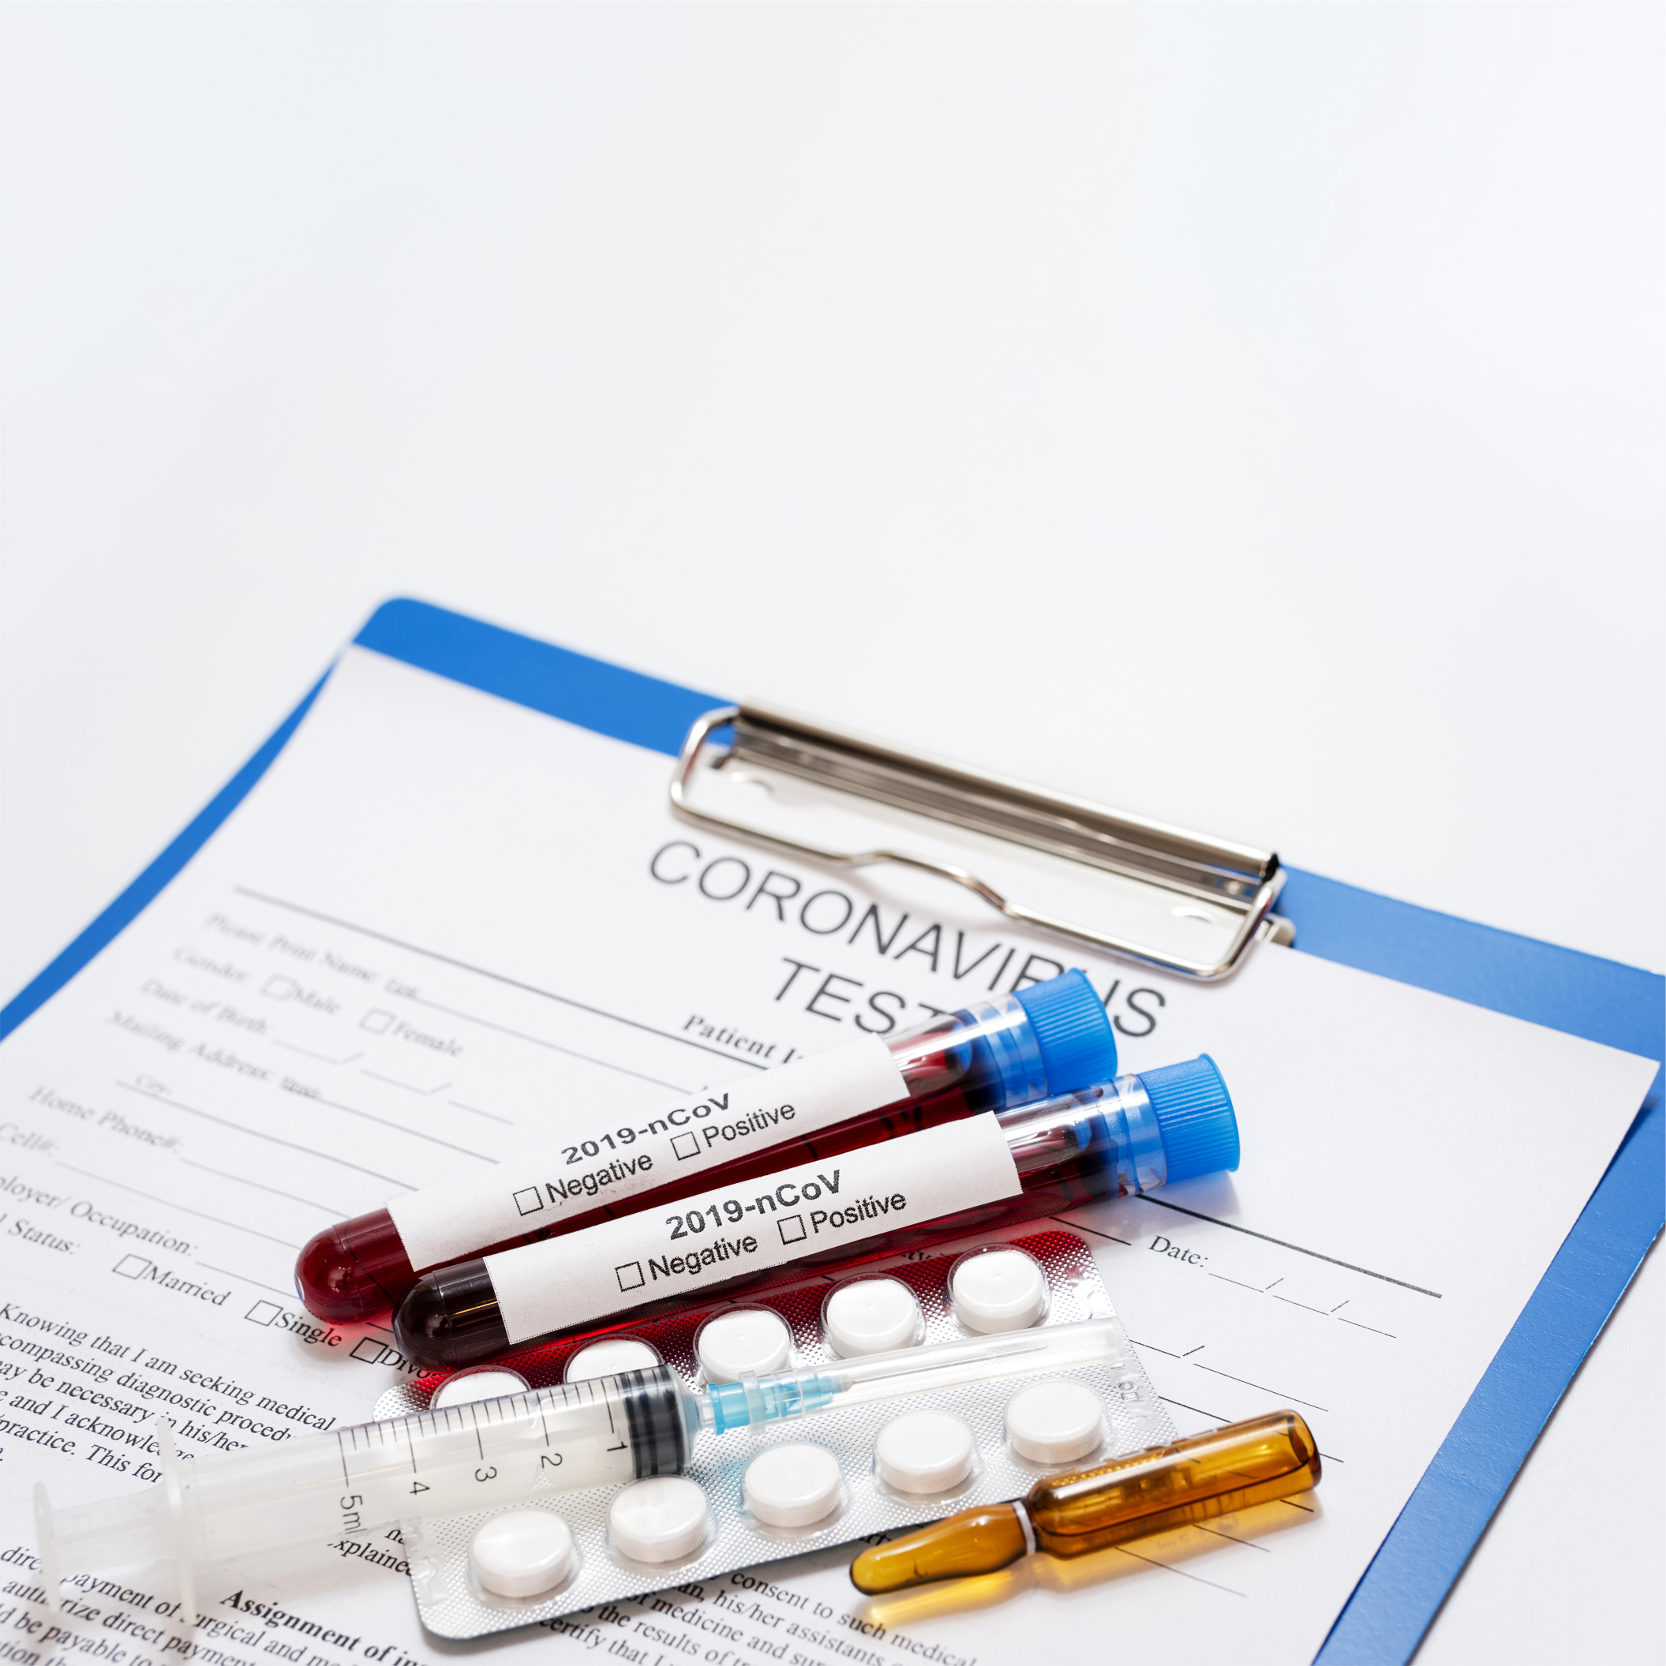
LABORATORY INVESTIGATIONS
D-dimer (0.71 - 28.50 mg/L)
Fibrinogen (0.46 - 5.80 g/L)
CRP, LDH
Antiphospholipid antibodies
Anti-cardiolipin Ab
Anti-β2-glycoprotein Ab

Slide 14
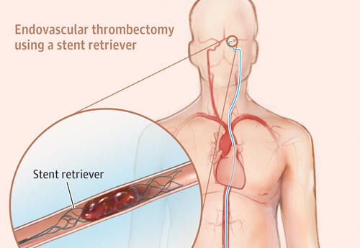
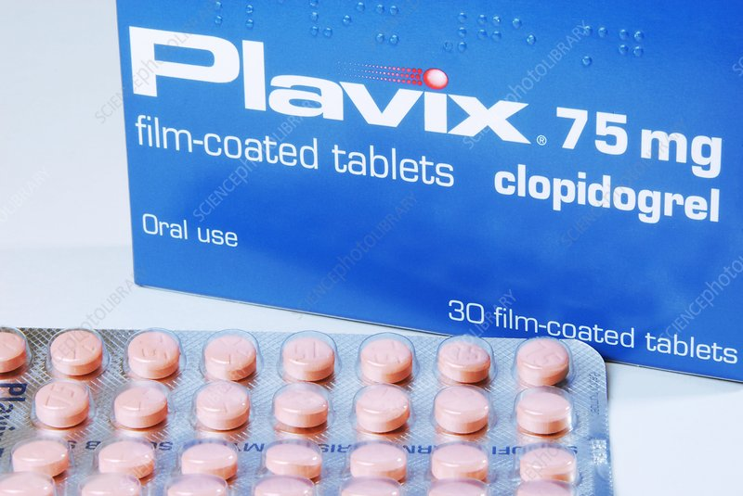
STROKE TREATMENT
Anticoagulation | 46.00% - 78.10%
Antiplatelet therapy | 12.00% - 80.00%
Mechanical thrombectomy | 3.22% - 48.00%
Intravenous (IV) thrombolysis | 4.55% - 25.00%

Slide 15
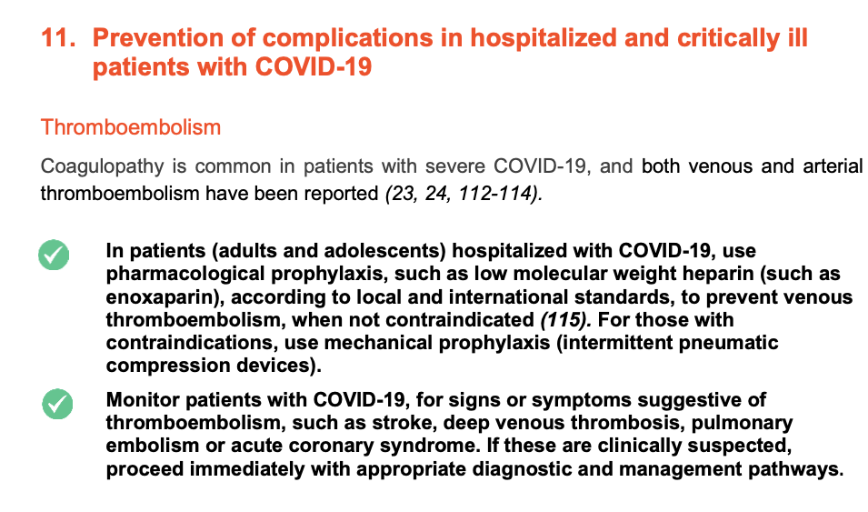
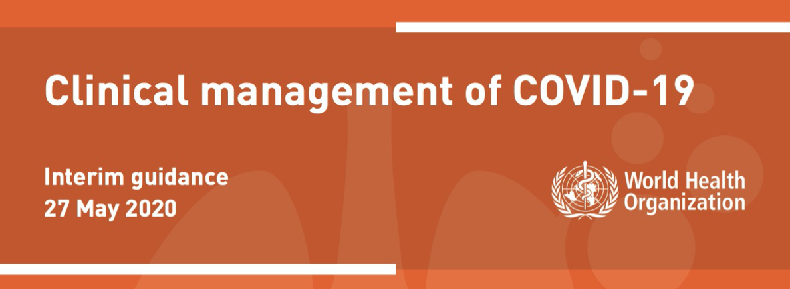
EARLY MANAGEMENT

Slide 16
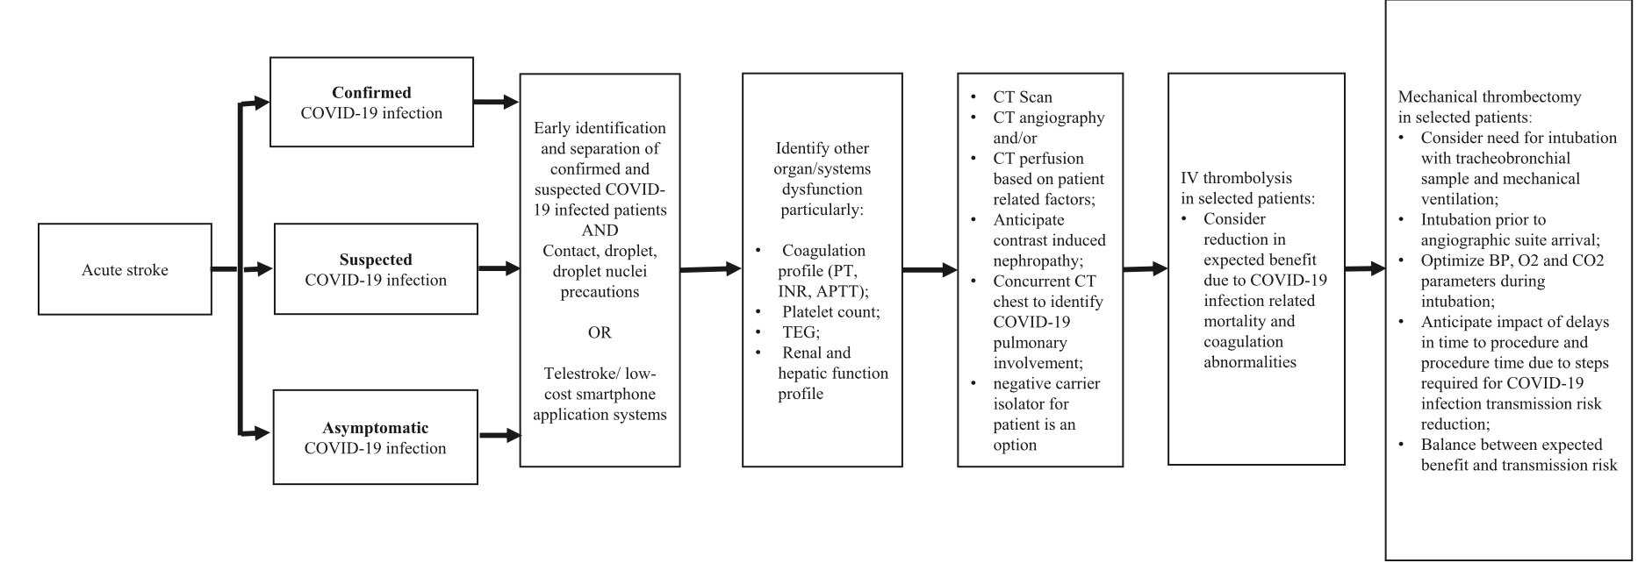
Management of AIS in patients with COVID-19: Insights from an international panel
DOI: https://doi.org/10.1016/j.ajem.2020.05.018

Slide 17

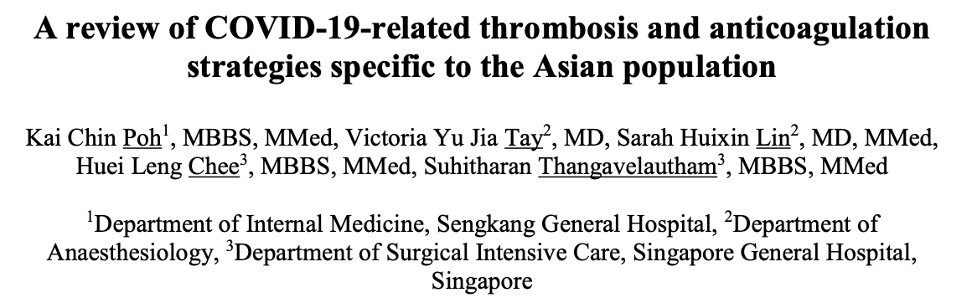
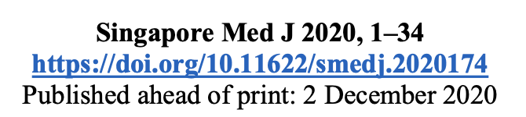
ANTICOAGULATION USE IN COVID-19

Slide 18
ANTICOAGULATION IN COVID-19
Findings:
Tang et al reported that the use of prophylactic doses of LMWH (40 - 60 mg/day) was associated with a significant reduction in 28-day mortality for patients with severe COVID-19 disease
Another study reported that the use of treatment doses of anticoagulation was associated with a significant reduction in hospital mortality rates (29.1% vs. 62.7%)

Slide 19
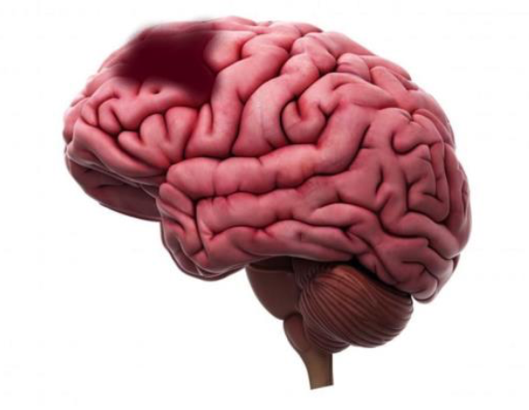

Conclusion
Most reported cases of stroke in COVID-19 patients are AIS.
Male predominance.
Most common comorbidities: hypertension, DM, hyperlipidemia
Relatively higher NIHSS score and mortality rate.
Laboratory findings are consistent with COVID-19 associated
coagulopathy (elevated D-dimer)
Early evaluation for acute neurologic changes, and timely work-up
needed to identify patients at-risk of developing stroke.

Slide 20
REFERENCES
Gupta A., Madhavan, M.V.M Sehgal, K. et al. Extrapulmonary manifestations of COVID-19. Nat Med 26, 1017-1032 (2020). https://doi.org/10.1038/s41591-020-0968-3
Oxley, T., Mocco, J., Majidi, S., et al. (2020). Large-Vessel Stroke as a Presenting Feature of Covid-19 in the Young. New England Journal Of Medicine, 382(20), e60. doi: 10.1056/nejmc2009787
Szegedi I, Orbán-Kálmándi R, et al. Stroke as a Potential Complication of COVID-19-Associated Coagulopathy: A Narrative and Systematic Review of the Literature. J Clin Med. 2020 Sep 28;9(10):3137. doi: 10.3390/jcm9103137
P. Belani, J. Schefflein, et al. COVID-19 Is an Independent Risk Factor for Acute Ischemic Stroke. American Journal of Neuroradiology June 2020, DOI: 10.3174/ajnr.A6650
Clinical management of COVID-19. (2021) https://www.who.int/publications/i/item/clinical-management-of-covid-19

Slide 21
REFERENCES
Qureshi AI, Abd-Allah F, et al. Management of acute ischemic stroke in patients with COVID-19 infection: Insights from an international panel. Am J Emerg Med. 2020 Jul;38(7):1548.e5-1548.e7. doi: 10.1016/j.ajem.2020.05.018
S. John, P. Kesav, et al. Characteristics of Large-Vessel Occlusion Associated with COVID-19 and Ischemic Stroke. American Journal of Neuroradiology Aug 2020, DOI: 10.3174/ajnr.A6799
Requena M, Olivé-Gadea M, et al. COVID-19 and Stroke: Incidence and Etiological Description in a High-Volume Center. J Stroke Cerebrovasc Dis. 2020 Nov;29(11):105225. doi: 10.1016/j.jstrokecerebrovasdis.2020.105225.
Poh KC, Tay VYJ, et al. A review of COVID-19-related thrombosis and anticoagulation strategies specific to the Asian population. Singapore Med J. 2020 Dec 2. doi: 10.11622/smedj.2020174.

