Slide 1

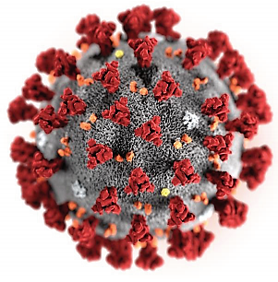
Management of COVID-19 in Ukraine
“This is a time for facts, not fear.
This is a time for rationality, not rumours.
This is a time for solidarity, not stigma.”
Tedros Adhanom Ghebreyesus
D.Sc., Prof. Bondarenko A.V.

Slide 2
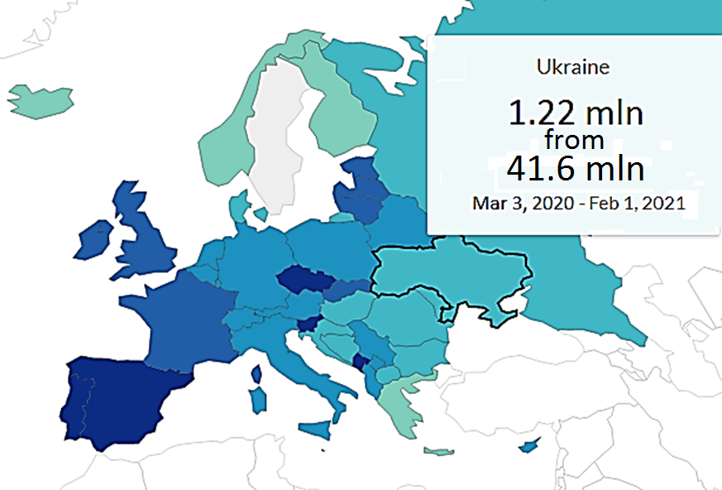
COVID-19 in Ukraine: confirmed cases
Ukraine is the largest all-European country.
The eighth-most populous country in Europe.
http://database.ukrcensus.gov.ua/PXWEB2007/eng/news/op_popul_e.asp

Slide 3
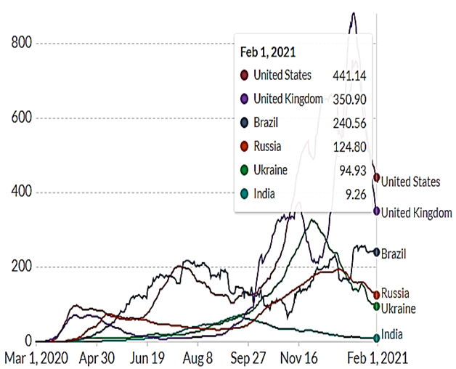
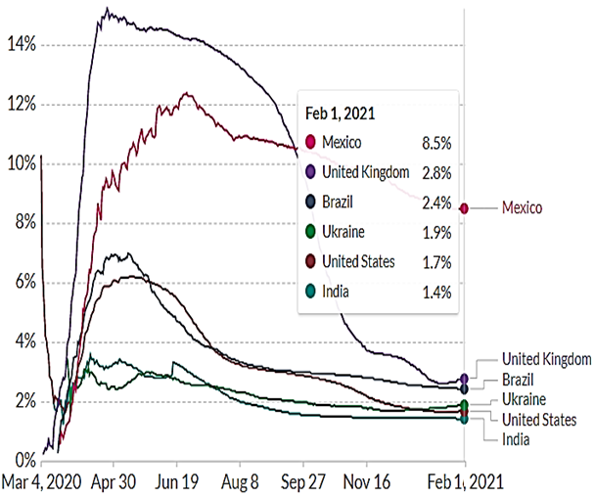
Top 5 countries plus Ukraine
Case fatality rate
Daily new confirmed cases (per mln)
COVID-19 Data Repository by the CSSE at Johns Hopkins University: https://github.com/CSSEGISandData/COVID-19

Slide 4
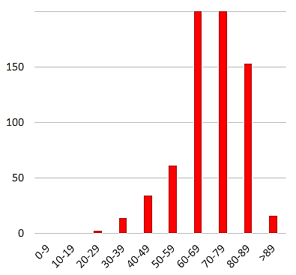
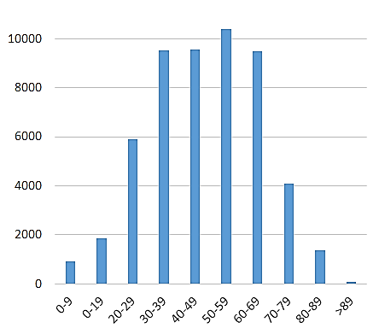
COVID-19 in Kharkiv
Kharkiv is the second largest city in Ukraine after Kiev with population of 1,44 mln people.
Outbreak period: Mar 27, 2020 – Feb 1, 2021
Confirmed cases: 53 217
Deaths: 706; CFR – 1.8
https://nszu.gov.ua/e-data/dashboard/covid19

Slide 5
Regional Clinical
Infectious Diseases Hospital, Kharkiv
Clinical base of Kharkiv National Medical University,
Kharkiv Medical Academy of Post-graduate Education
The ﬁrst designated hospital for management of COVID-19 patients in Kharkiv and all suspected or conﬁrmed cases in the city were compulsorily admitted to it.
From Mar 2020 till Feb 2021 we treated >5000 patients (≈10% of confirmed cases).

Slide 6
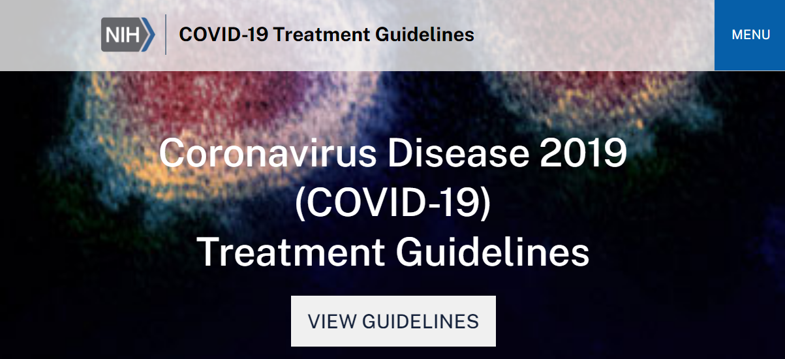

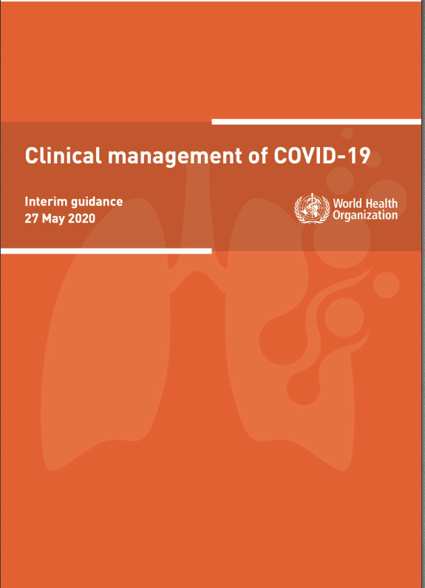
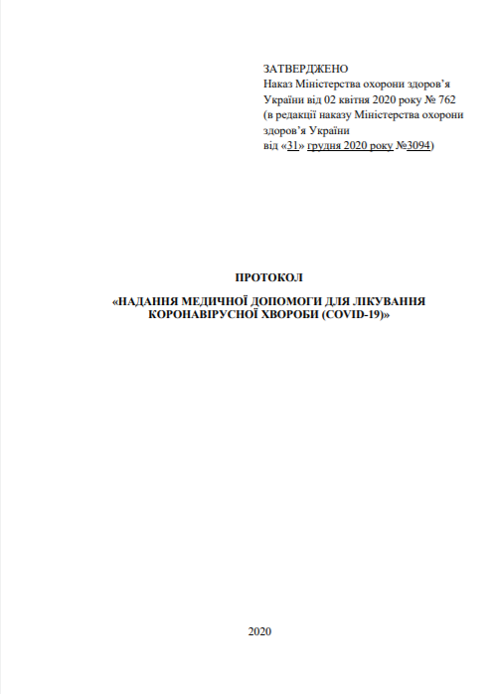

Slide 7
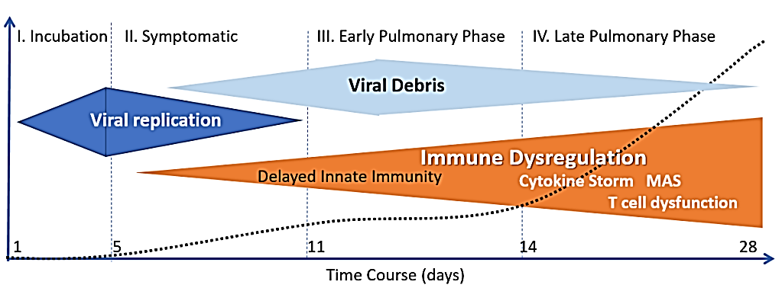
The course of COVID-19
https://covid19criticalcare.com/wp-content/uploads/2020/12/FLCCC-Protocols-–-A-Guide-to-the-Management-of-COVID-19.pdf

Slide 8
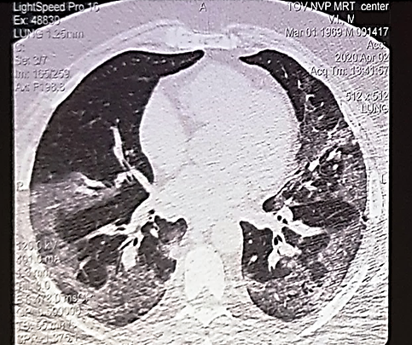
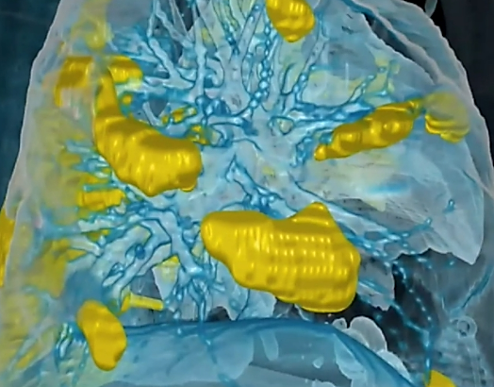
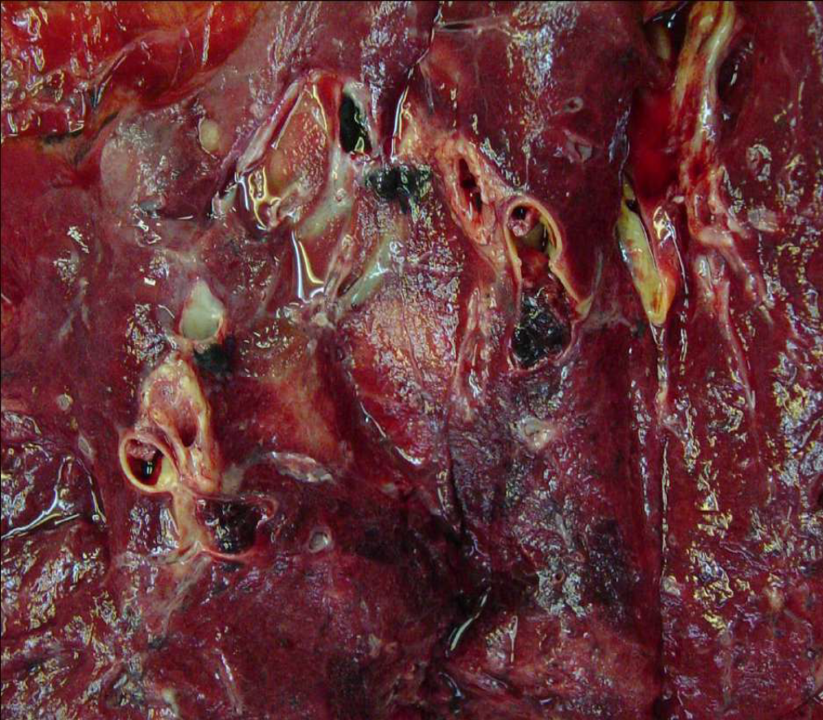
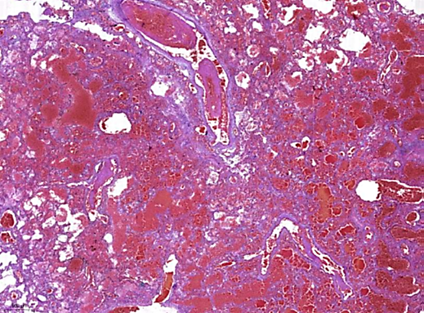
George Washington University Hospital/Surgical Theater

Slide 9
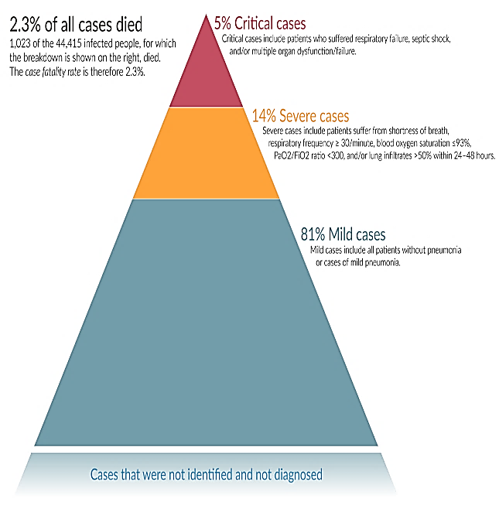
The course of COVID-19
A Cytokine Storm and Macrophage Activation Syndrome are overreactions of the body's immune system.
https://covid19criticalcare.com/wp-content/uploads/2020/12/FLCCC-Protocols-–-A-Guide-to-the-Management-of-COVID-19.pdf

Slide 10
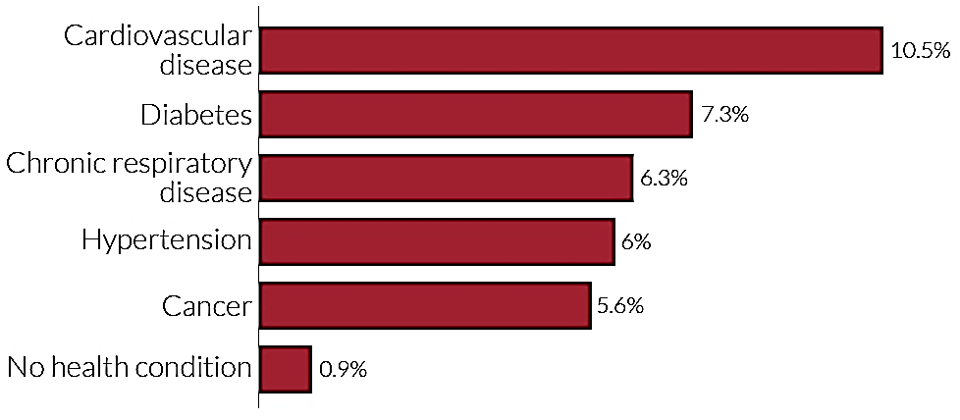
High risk groups
Coronavirus can make anyone seriously ill. But for some people, the risk is higher:
People aged 60 years and older
Chronic respiratory disease
Chronic kidney disease
Cardiovascular disease
Neurologic conditions
Immunocompromised state
Liver disease
Cancer
Obesity
Pregnancy
Smoking
Diabetes mellitus
Case fatality rate by preexisting health conditions
https://ourworldindata.org/mortality-risk-covid#case-fatality-rate-of-covid-19-by-age

Slide 11
The role of glucocorticoids
inhibiting the inﬂammatory storm;
reduce endothelial leakage, while effectively stopping the inflammatory cascade;
effects are dose-dependent, with immunosuppressive effects seen mostly at higher doses;
immediate effects of glucocorticoids are supposed to be mediated through non-genomic actions within the cell and occur with high doses.

Slide 12
Methylprednisolone & COVID-19
an early short course in moderate to severe COVID-19 reduced escalation of care and improved clinical outcomes [Fadel R. et al., 2020];
a high dose (1000 or 500 mg/day) and short term provide a better prognosis of patients with C-ARDS [So C., 2000].
appears to have reduced the risk of death in C-ARDS [Wu C.et al., 2020];
severe COVID-19 patients improved their oxygenation significantly with no negative impact on viral clearance [Liu J., 2000].
NB! After the discontinuation of hormone therapy, a new outbreak of the disease activity may be observed.

Slide 13
High-dose intravenous methylprednisolone therapy
Dosage | Treatment interval
1000 mg | 3 days
500 mg | 1 - 3 days
250 mg | 1 - 3 days
125 mg | 1 - 3 days
80 mg | 1 - 3 days
40 mg | 1 - 5 days
The reduction in the dose of MP begins under reducing in the level of CRP no less than 15%!
The cumulative dose should not exceed 6 g!

Slide 14
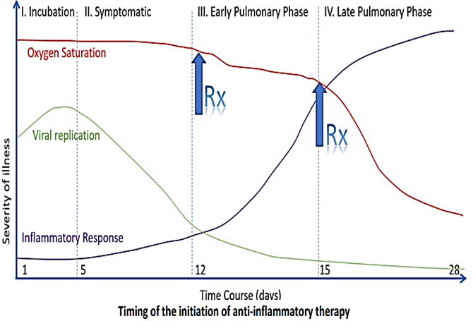
High-dose intravenous methylprednisolone therapy
Prescribe not earlier than 7th day from the beginning of clinical symptoms!

Slide 15
Criteria for starting HIMP therapy
age < 65 years;
the C-reactive protein level is over 50 units or it’s progressive increase by 5 times and higher on 8-15 day;
leukocyte level < 3,0 × 10⁹/L;
absolute level of lymphocytes < 1 × 10⁹/L or two or three lineages cytopenia;
increased ferritin level > 500 ng/ml;
IL-6 level > 40 ng/ml;
lung infiltrates > 50% with their progression within 24-48 hours;
fever 38 °C and higher for > 3 days;
a rapid tendency to reduce saturation (respiration frequency ≥30 / min; SpO2≤92%).

Slide 16

High-dose intravenous methylprednisolone therapy
was shown to decrease activity of systemic inflammatory response, severity of coagulation disorders and contribute to recovery of gas exchange lung function;
no patients required an enhancement of respiratory support (transfer to ICU);
was well­tolerated and did not cause bacterial complications.

Slide 17
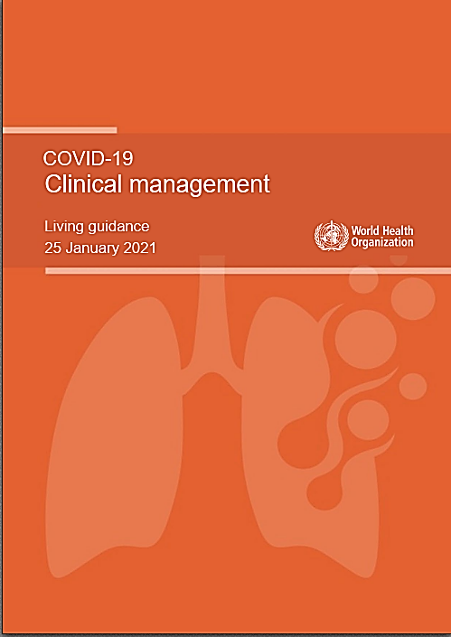
Clinical management of COVID-19 – WHO, 25 Jan 2021
This guideline contains the following recommendations:
Strong recommendations against the use of hydroxychloroquine and lopinavir/ritonavir.
A conditional recommendation against remdesivir in hospitalized patients.
A strong recommendation for systemic corticosteroids in patients with severe and critical COVID-19.
A conditional recommendation against systemic corticosteroids in patients with non-severe COVID-19.

Slide 18
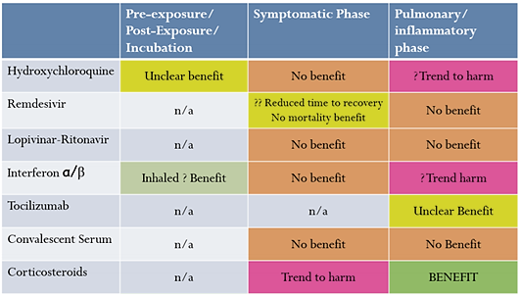
Pharmacological therapy for COVID-19
https://covid19criticalcare.com/wp-content/uploads/2020/12/FLCCC-Protocols-–-A-Guide-to-the-Management-of-COVID-19.pdf

Slide 19
THIS IS A STEROID RESPONSIVE DISEASE & TIMING IS CRITICAL
Early recognition and effective suppression of the cytokine storm may be life-saving in severe or critical patients.
We recommend high dosage intravenous methylprednisolone to address the immediate need to reduce the rising mortality.
Timely and appropriate application of methylprednisolone could avoid the need for invasive mechanical ventilation and improve the outcomes of critical patients.

Slide 20
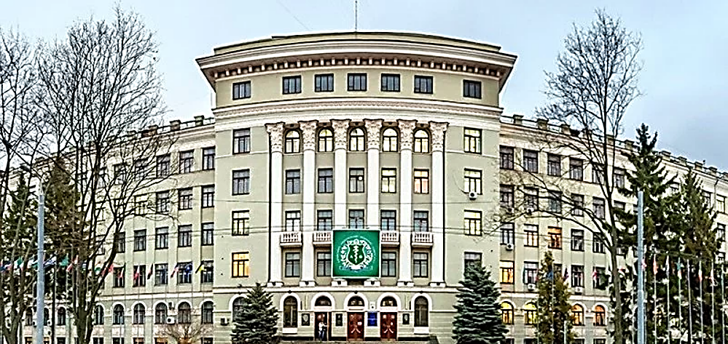
Thank you!

