Slide 1
Attitudes of the adult general population towards wearable technologies and its implication to health in the Kingdom of Bahrain
Mohamed Janahi, Abdulrahman Janahi, Sara Almisrea, Yousef Alobaywi, Turki Bensgayan, Omar A. Alhaj, Haitham Jahrami

Slide 2
Objectives:
This study aims to increase the knowledge about the adult Bahraini population’s attitude towards wearable technologies and to assess the sleep quality and body mass index in wearable users.

Slide 3
Literature search and background
Wearable technology has been involved almost in every aspect of life, especially with internet connectivity, it has improved education, health, hospitality services, labor productivity, retail, and many more
Nowadays, the wearable technologies market is showing a massive growth and is expected to show a greater growth in the following couple of years.
Until 2015, more than 165,000 health-related apps were available on the market. The vast majority of these apps are designed to improve general wellness and lifestyle by making users aware of their daily caloric intake, activity, tracking sleep cycle, and female health.
(IMS Institute for Healthcare Informatics, 2015)

Slide 4
Methods
Design: a cross-sectional study
Sample: The data was collected from the general population of Bahrain include people who used wearable devices.
The inclusion criteria were as follows
  Age group between 15 – 64 years of age and participants using wearable devices without medical illness.
The exclusion criteria include
  The participants that did not meet the required criteria had insufficient data, and were excluded from the research.
  Having past medical or psychiatric comorbidity.

Slide 5
Procedures
This comparative cross-sectional study was drafted, and the data was acquired using web-based survey services. The services allowed for the design of questionnaires and the collection of data.
The data were collected between August and September 2020. The questionnaire was distributed through email, WhatsApp, Facebook, and other social media platforms.
A total of 1092 contacts, describing the survey including a link inviting them to complete the questionnaire, with interesting wearable devices consumers being invited to complete the questionnaire.

Slide 6
Procedures
Furthermore, The Pittsburgh Sleep Quality Index (PSQI) is used to assess sleep quality.
Self-reported body weight (in kilograms) and height (in meters) were obtained to compute Body Mass Index (BMI kg/m2).(21) Self-reported anthropometric measures have consistently shown to be a valid approach to collect data.

Slide 7
Data analysis
Descriptive analyses was conducted using STATA version 16.1 (22) (STATA Institute Inc) to cross variables according to several criteria.
The pattern of answers was analyzed by responders’ age and their technological level, also, the composition of the advisory board of the patients’ health care advocacy associations was considered as a possible confounding factor.
The statistical test (P-value) was expected only for results that gave significant patterns using a predetermined alpha level of 0.05.

Slide 8
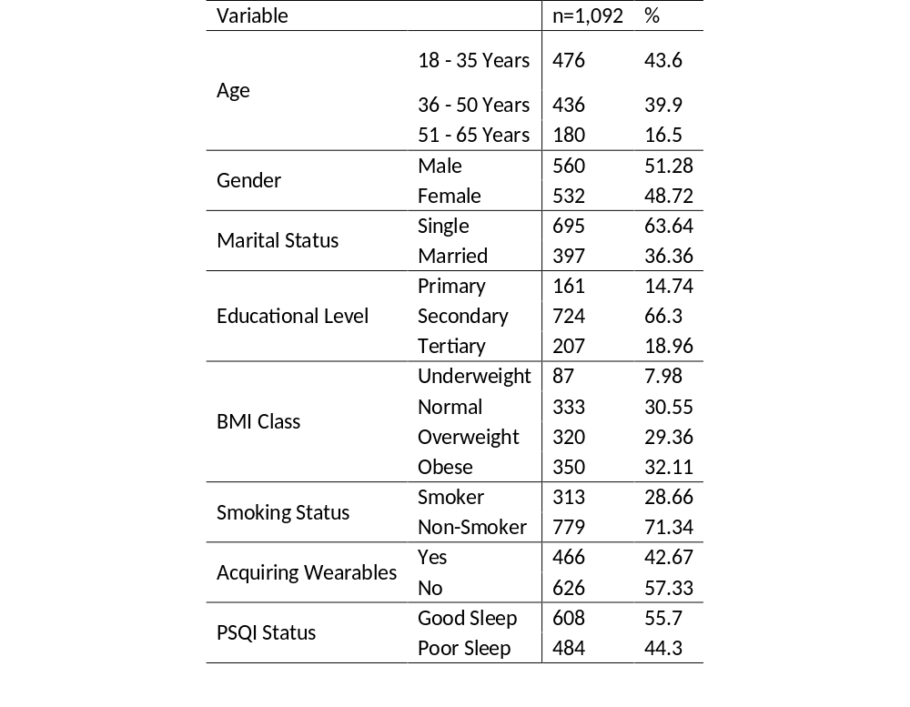
Demography

Slide 9
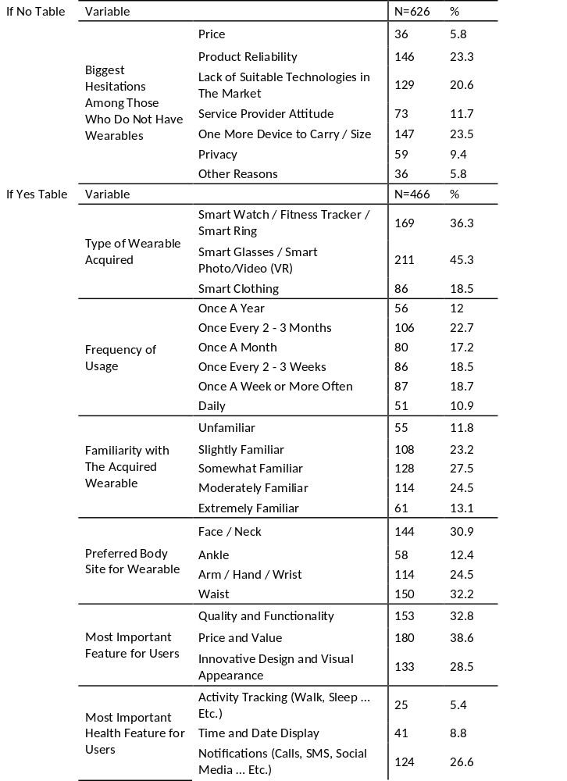
Results of reasons among those who do not wear wearable devices

Slide 10
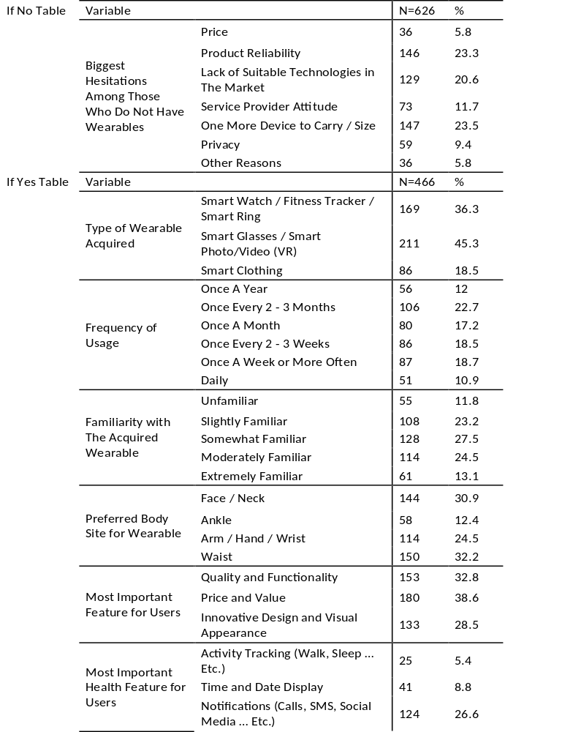
Results of reasons among those who wear wearable devices

Slide 11
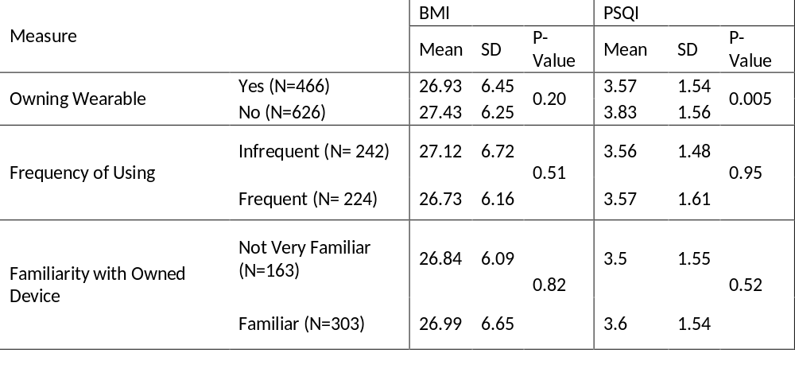
Association between wearing wearable devices and, BMI and sleep

Slide 12
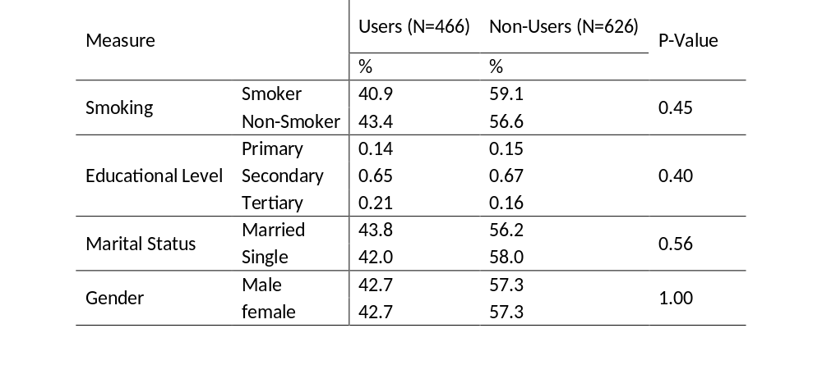
Other factors

Slide 13
Conclusion
Undoubtedly, using wearable devices with the aim of monitoring health measures and improving lifestyle is useful.
Yet the present study showed no association between using wearables, the frequency of usage and the familiarity of users with their owned devices and, sleep quality and BMI in the adult Bahraini population, even though the majority of users are familiar with their devices.
This may be attributed to the fact that the vast majority of our respondents use wearables very infrequent and only around 10% of wearable users use their devices on a daily basis.

Slide 14
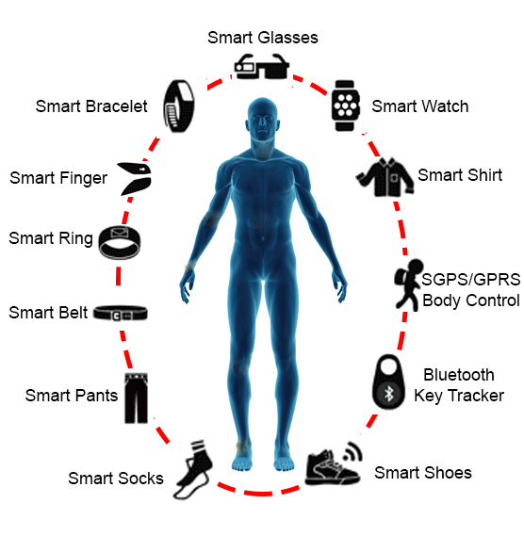
conclusion
This research lies in being the largest in terms of sample size in the region up to the authors’ knowledge.
Therefore, it forms a basis for future public health research to reveal the impact of wearable technologies usage on health.

