Slide 1
HOW COVID19 PRODUCE DISEASE
Images used from the internet is for educational purposes only and is based under the fair use doctrine. Credits are given to the original sources.
ICON-Megopic2021
27 February 2021
A/P Dr Fidel Fernandez
Pathologist
Notes:
First of all I would like to thank the organizers of this conference, Taylors University and all collaborating institutions for inviting me to be a part of this conference. It is my pleasure and my honor. Bear with me in my attempt to speak in simple terms as I can… a challenge indeed.
Its been over a year since mankind has been waging war against this invisible enemy called SARS COV2 otherwise known as covid19. Now an important factor to consider in order to win battles is to know the enemy, how it attacks and know its weapons used to attack and inflict damage.. it is by knowing these factors that we can create a winning formula against this invader. My job as a pathologist therefore is to thresh out and present to you in simple terms the mechanism on how this virus invade, produce injury and death to humans.

Slide 2
Objective
To describe the pathophysiology of Covid 19 in easy to understand terms for both the scientific community and the general public.
Provide relevant concepts in the understanding of covid 19 disease suitable for medical students and medical professionals.
To provide possible research ideas focused on mechanisms of disease of viral infections.

Slide 3
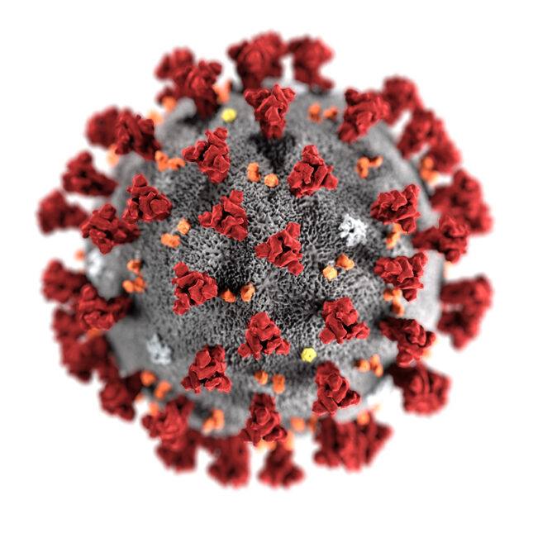

Introduction
Covid 19- Corona Virus Disease 2019
SARS COV 2- Severe Acute Respiratory Syndrome
due to Corona Virus 2
Notes:
Let me start by taking up the meaning of its name, I prefer to label this invader as SARS COV 2 because it identifies its nature and also describes the disease it produces. We know that this is a kind of a virus called corona virus due to its structure (see image or corona virus), It is number 2 because there is a cov 1 strain. It is labelled as SARS because of the disease it causes. It is Severe meaning deadly or causes serious damage to tissues, Acute meaning sudden or immediate therefore its disease manifest very early, Respiratory because it primarily attacks the respiratory system, airpassages and lungs and Syndrome since other organ systems of our body may likewise be affected severely such as the CNS, GIT, KIDNEY, RES. Causing signs or symptoms referrable to these organs.

Slide 4
Stages of the disease
Attachment
Entry by endocytosis
Replication
Release of virions
Viremia
Dissemination
Inflammatory response
cytokine storm
ARDS
DIC
Death
INITIAL STAGES
INFLAMMATORY STAGES
TERMINAL STAGES
Notes:
The infection take place in this way.. The initial stage begin with the attachment of the virus to the host cell via its receptor (ACE2) these receptors and densely found in of the respiratory passages, lungs, blood vessels and other tissues. The virus is then taken in by the cell and replicates inside the cell utilizing the host cell mechanisms. An important weapon of this virus is its ability to multiply exponentially that is a number multiplied by itself, one becomes 2 and 2x2, 4x4 etc. So you see, the onset of its damage is quick. While multitudes of viruses are released it invades the blood (viremia) and reaches other systems causing the same damage to cells. Meanwhile our body reacts from the time the virus enters and stimulates an inflammatory reaction. The inflammatory response get intensified as the virus multiplies and spread to other organ systems.

Slide 5
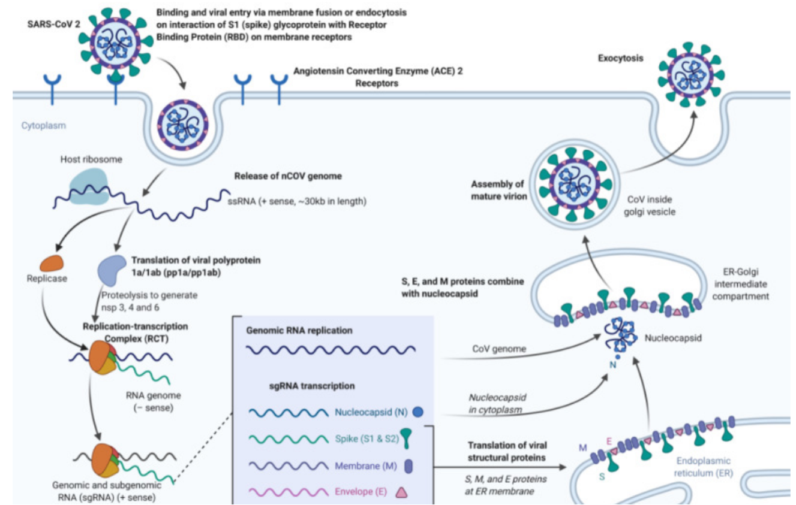
ATTACHMENT AND ENTRY
MULTIPLICATION AND RELEASE
Corrupts cell mechanisms producing the viral parts
Notes:
This diagram show the method of entry of the virus into the host cell like a “trojan horse” it then uses the host cell mechanism to multiply and destroys the cell as it releases multitudes of its kind. As the virus multiplies it invades other systems of the body and intensifies the inflammatory response

Slide 6
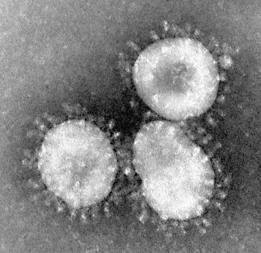
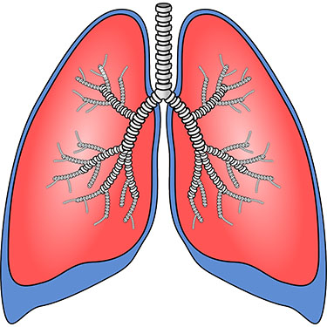


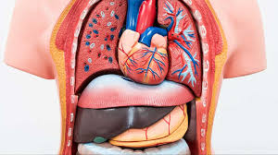

INTERSTITIAL
PNEUMONIA
RESPIRATORY SYSTEM
HYPOXEMIA
INFLAMMATORY MEDIATORS- ARDS CYTOKINES
MULTI ORGAN SYSTEM
CYTOKINE STORM
DIC
Multi organ Failure
DEATH
Notes:
We see the scenario on how the virus enters and produces damage to multiple organ systems. It predominantly affects the lungs producing interstitial pneumonia which progresses to obliterative alveolitis, bronchiolitis obliterans. There is hypoxemia which is refractory to oxygen therapy due to the block to the exchanges of gases. Then inflammatory mediators are released by inflammatory cells called cytokines (cyto- kinetic) which later overwhelms the systems by the on all other organs. This is in response to the continuous increase in the number of viruses released by infected cells. The final stages will be CYTOKINE STORM which continuous on to develop DIC (disseminated intravascular coagulation) and finally multiorgan failure and DEATH.

Slide 7
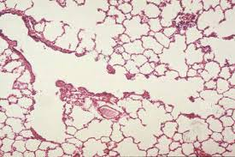
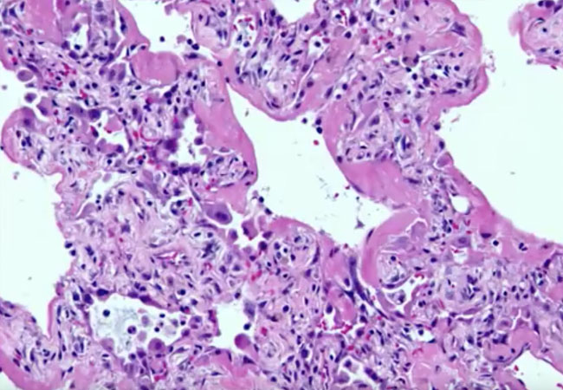
Pathologic changes
INTERSTITIAL PNEUMONIA
ACUTE RESPIRATORY DISTRESS SYNDROME
Viral particles in the pneumocytes
diffuse alveolar damage, with the presence of multinucleated pneumocytes.
Fibrogranulation tissue proliferation in small airways and airspaces -bronchiolitis obliterans
organising pneumonia-like lesions).
Notes:
Take a look at a normal lung tissue, see that it is mostly air space with thin walls. To appreciate the changes in interstitial pneumonia.
Interstitial pneumonia- widening of the alveolar walls producing block of air exchanges, later alveolar consolidation further increasing hypoxemia
ARDS- diffuse alveolar damage; refractory hypoxemia, decreased lung compliance, hyaline membrand and consolidation of lung.

Slide 8
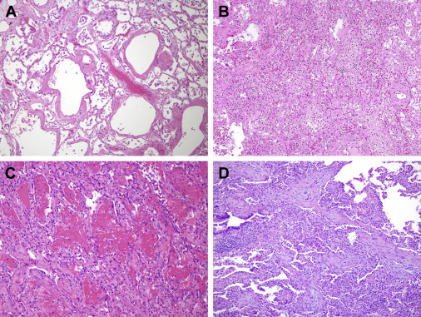

A. ACUTE EXUDATIVE PHASE(DAD)
B. PROLIFERATIVE PHASE (DAD)
C. ACUTE FIBRINOUS ORG PNEMONIA
D. ORGANIZED PNEUMONIA (OP)

Slide 9
Pathologic changes
In other organs
Predominantly inflammatory which is immune mediated

Slide 10
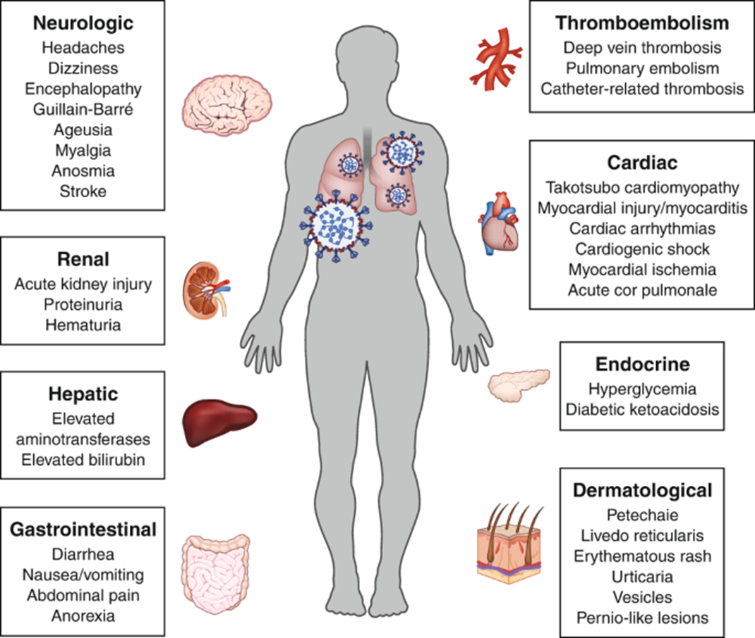
THAT’S ALL FOR NOW.. THANK YOU FOR LISTENING

Slide 11
Referrences
https://www.ncbi.nlm.nih.gov/pmc/articles/PMC7169933/
https://www.ncbi.nlm.nih.gov/pmc/articles/PMC7320676/
https://www.nature.com/articles/s41401-020-00554-8#Sec4
https://www.nature.com/articles/s41401-020-00554-8
https://www.medrxiv.org/content/10.1101/2020.07.02.20145003v1
https://journal.chestnet.org/article/S0012-3692(20)34868-6/fulltext

Slide 12
That’s about it
Thank you for listening.
Be safe

