Slide 1
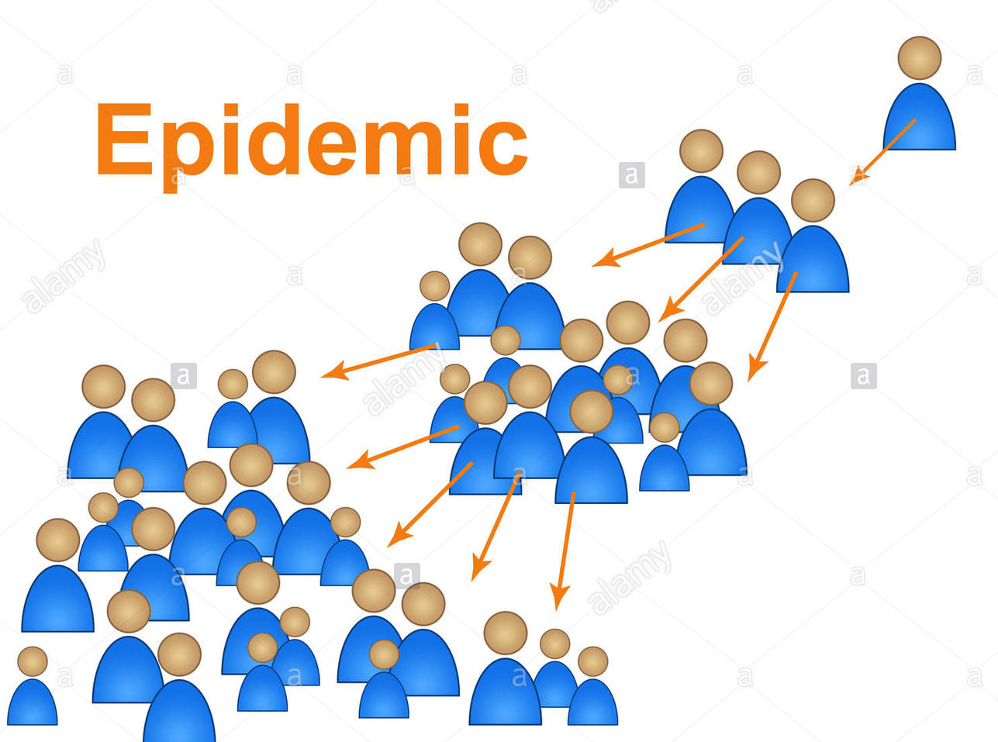


ICON-MEGOPIC2021:
MEDICAL GOES PUBLIC
28 Feb 2021
CoVID-19 SOPs: Community empowerment
Prof Dr adlina Suleiman
Head of medicine and health cluster,
Academy of professors Malaysia
Lecturer community medicine dept. ,
international medical university

Slide 2
CONTENTS
COVID-19 FACTS
CORONAVIRUS TRANSMISSION AND HOW TO BREAK IT
CURRENT SOPs
WHAT IS COMMUNITY EMPOWERMENT?
WHY IS COMMUNITY EMPOWERMENT SO IMPORTANT?
A LITTLE BIT ABOUT THE VACCINE

Slide 3
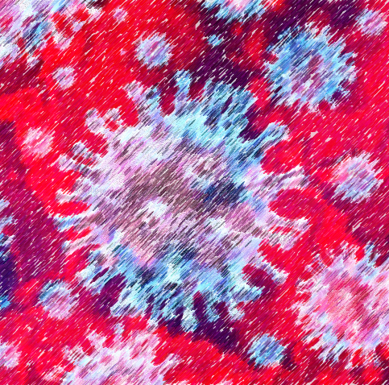
Coronavirus
Classification
Coronaviruses (and toroviruses) are classified together on the basis of the crown or halo-like appearance of the envelope glycoproteins, and on characteristic features of chemistry and replication.
Most human coronaviruses fall into one of two serotypes: OC43-like and 229E-like.

Slide 4
What is COVID-19?
Coronavirus (COVID-19) is an illness caused by a virus that can spread from person to person.
The virus that causes COVID-19 is a new coronavirus that has spread throughout the world.
COVID-19 symptoms can range from mild (or no symptoms) to severe illness.
https://www.cdc.gov/coronavirus/2019-ncov/downloads/2019-ncov-factsheet.pdf

Slide 5

Coronavirus multiplication
When someone becomes infected with the novel coronavirus SARS-CoV-2, the pathogen proliferates rapidly in the cells of the infected person.
The virus has to multiply its genetic material, which consists of a single long RNA strand. This task is performed by the viral “copy machine”, the so-called polymerase.
(The virus enters the host cell, and the uncoated genome is transcribed and translated. The mRNAs form a unique “nested set” sharing a common 3′ end. New virions form by budding from host cell membranes)

Slide 6
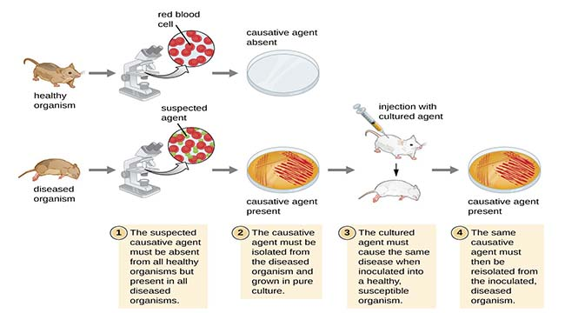
Koch's postulates are four criteria designed to establish a causative relationship between a microbe and a disease.

Slide 7
CORONAVIRUS TRANSMISSION: Direct (close contact and fomites) and Indirect Transmission (airborne)
You can become infected by coming into close contact (about 6 feet or two arm lengths) with a person who has COVID-19. COVID-19 is primarily spread from person to person.
You can become infected from respiratory droplets when an infected person coughs, sneezes, or talks.
You may also be able to get it by touching a surface or object that has the virus on it, and then by touching your mouth, nose, or eyes.
https://www.cdc.gov/coronavirus/2019-ncov/downloads/2019-ncov-factsheet.pdf

Slide 8
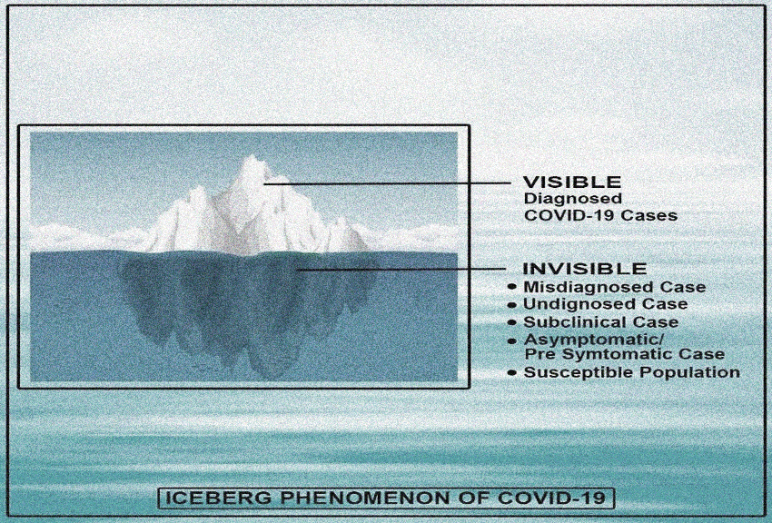
How far has it spread? R0 2
1000 people can transmit to 2000 who can transmit to 4000
In 7 days the number is a staggering 128,000
In 14 days it is 16,384,000
So……..the cases you see now is tip of the iceberg

Slide 9
Basic Principles In Communicable Disease
Prevention and Control
Agent Kill the agent
(use drugs)/or kill the host)
Sanitary disposal of discharges Portal of exit or bodies
Transmission
- direct Break transmission
- indirect isolate/quarantine, vector control, clean water supply, sewage garbage management
clean food, sterile suits(PPE), use masks
Portal of entry wash hands, use gloves
Susceptible host
Vaccination, Chemoprophylaxis

Slide 10
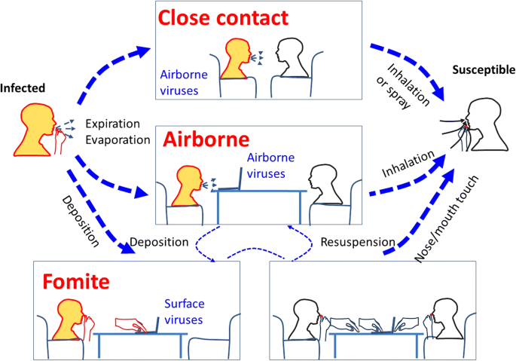

Slide 11
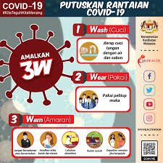
Protect Yourself (Primary Prevention)
There is currently no vaccine to protect against COVID-19. There is also no cure.
The best way to protect yourself is to avoid being exposed to the virus that causes COVID-19. • Stay home as much as possible and avoid close contact with others.
• Wear a mask that covers your nose and mouth in public settings.
• Clean and disinfect frequently touched surfaces.
• Wash your hands often with soap and water for at least 20 seconds, or use an alcoholbased hand sanitizer that contains at least 60% alcohol.
https://www.cdc.gov/coronavirus/2019-ncov/downloads/2019-ncov-factsheet.pdf

Slide 12
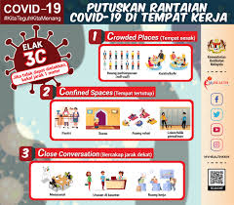
Avoid Crowded Places, Confined Places and Close Conversation
Buy groceries and medicine, go to the doctor, and complete banking activities online when possible.
If you must go in person, stay at least 6 feet away from others and disinfect items you must touch.
Get deliveries and takeout, and limit in-person contact as much as possible.
Everyone is at risk of getting COVID-19.
Older adults and people of any age who have serious underlying medical conditions may be at higher risk for more severe illness. (It is better for them to stay home)
https://www.cdc.gov/coronavirus/2019-ncov/downloads/2019-ncov-factsheet.pdf

Slide 13
If you are sick:
Stay home if you are sick, except to get medical care.
Avoid public transportation, ride-sharing, or taxis.
Separate yourself from other people and pets in your home.
There is no specific treatment for COVID-19, but you can seek medical care to help relieve your symptoms.
If you need medical attention, call ahead.

Slide 14
Community empowerment is crucial to guide, advise and help Malaysians combat Covid-19
(Tan Sri Lee Lam Thye, Alliance for Safe Community chairman NST Dec 13 2020)
Defined as freedom and authority entrusted to members of a community to be proactive to pursue their vision and mission to make their community free from unwanted accidents, diseases, injuries or deaths.
"When everyone in the community shares responsibility for safety and health, the community is assured of its best protection.
Safety must be accepted as a cherished personal value which must be practiced in all aspects of our lives, whether at the workplace, on the road, in the home, in our schools, in sports and recreation."
The real impact of diseases such as Covid-19 is better understood by the unfortunate victims and their family members, those who have lost their loved ones, their lives will never be the same again.
Challenge - to impress upon everyone the real impact that Covid-19 has on human lives and the need for everything possible to be done for its prevention
No amount of effort by the health authorities and frontliners would be effective if the community is not prepared to empower itself to ensure the health and safety of its members.
Community Empowerment &
Community Responsibility

Slide 15
"Safety is for everyone.”
“Preventing harm to yourself, your family, your friends and your community gives you greater peace of mind”
For safety to effectively encompass all aspects of life and reinforced as a shared value, lifestyle and attitude, it is vital there be involvement and participation by the community.
Achieved through community outreach educational programs jointly organized by various government agencies, professional bodies and NGOs - targeted not just at the working population but the elderly, housewives, hawkers, shopkeepers and young children.
Communities in which there is a strong culture, members of the community would have high expectations on safety standards and low or zero tolerance of anything that poses a hazard to the community or to individuals.

Slide 16
MCO negative implications: 1.Economy shrank by 3.4 per cent in the fourth quarter or contracted 5.6 per cent in the entire economic year of 2020.
2. National Statistics Dept. data : over 772,000 individuals were unemployed, bringing the national unemployment rate in December 2020 last year to 4.8 per cent.
EXIT POLICY needs Community Involvement
The exit policy emphasizes on efforts to educate (wearing face masks, maintaining physical distancing and personal hygiene) and increase public awareness and compliance with the new norm and SOPs to curb the pandemic
(government playing only a role in terms of law enforcement and monitoring of SOP compliance)
Every individual, family, community and the economic sector will be empowered to voluntarily take care of each other
( government strives on reviving the economy, luring foreign investors, creating jobs, ensuring public access to the vaccine and safeguarding national borders)

Slide 17
Our People Are Compliant: Level of people’s compliance with the SOP is quite high 98.5%...only 1.5% is still flouting
The virus is already in the community. There are over 50,000 active cases. Important to
Continue to educate and enhance awareness among the public
Start vaccination to front-liners, locals and foreigners as soon as possible
Empowerment of individuals, community and economic sector to adapt to the new norm, SOP compliance and taking care of each other is the optional exit policy for the government to address Covid-19, anticipated to continue to be active until 2023.
The World Health Organization (WHO) has warned that people in poor countries will not be vaccinated until 2023 - leaving the world not fully safe for the next three years.

Slide 18
In Conclusion:
So What Does the Community Need to Do?
What Do You Need to Do?
Diligently follow the SOP of Wearing Mask, Washing Hands, Warning (watch distance, warn others not complying, go to clinic early if develop symptoms)
Avoid Crowded Places, Confined Spaces and Close Conversation. If possible be in an open air environment (exercise outside daily), spend as little time in an air conditioned closed space, do not hold any party or events)
Help each other, there may be people who are vulnerable or displaced within the community, those who have lost their source of income, those whose family members have died of COVID-19…….assist wherever you can in monetary or in kind.
Have a security system that places your community within an enclosure that you have set up with your local Rukum Tetangga, Security company, residential group……control movement in and out of your area, assist families with positive individuals to cope with their home quarantine, help your neighbours,………..BE CARING, BE KIND
WE CAN GET THROUGH THIS TOGETHER

Slide 19
35-year study hints that coronavirus immunity doesn't last long
In a new study, published Sept. 14 in the journal Nature Medicine, scientists monitored 10 individuals for more than 35 years to determine how often they became infected with the four known seasonal coronaviruses.
Since these viruses — known as HCoV-NL63, HCoV-229E, HCoV-OC43 and HCoV-HKU1 — either cause mild symptoms of the common cold or no symptoms at all, the team periodically screened the participants' blood for antibodies to spot new cases of infection.
https://www.livescience.com/seasonal-coronavirus-immunity-reinfection.html

Slide 20
Implications
As people gain immunity to the virus, either through natural infections or a future vaccine, it will be important to track how long that immunity lasts.
It's possible that people will need to be vaccinated on a recurring basis to keep the virus at bay.

Slide 21
Some Facts on Reinfections
Each participant caught three to 17 coronavirus infections within the study period, with reinfections occurring every six months to eight years and nine months.
Most often, reinfection of a particular coronavirus occurred about a year after the prior infection.
Reinfections by natural infection occur for all four seasonal coronaviruses, suggesting that it is a common feature for all human coronaviruses, including SARS-CoV-2, the virus that causes COVID-19.
https://www.livescience.com/seasonal-coronavirus-immunity-reinfection.html

Slide 22
New Issues on COVID-19 pandemic
New coronavirus variants could lead to a rapid rise in the numbers of Covid-19 cases, according to two new reports (US Centers for Disease Control and Prevention).
The rollout of the Johnson & Johnson vaccine will be slower than US federal health officials initially anticipated (CNN)
The coronavirus variant first identified in the UK has now been found in 94 countries. The variant first identified in South Africa has been found in 46 countries, and the variant first identified in Brazil in 21, (WHO)

Slide 23
Pathways to develop and produce a COVID-19 vaccine
Global health authorities and vaccine developers are currently partnering to
support the technology needed to produce vaccines.
1. Live vaccines
Live vaccines use a weakened (attenuated) form of the germ that causes a disease. This kind of vaccine prompts an immune response without causing disease. The term attenuated means that the vaccine's ability to cause disease has been reduced.
Live vaccines are used to protect against measles, mumps, rubella, smallpox and
chickenpox. As a result, the infrastructure is in place to develop these kinds of vaccines.
However, live virus vaccines often need extensive safety testing. Some live viruses can be transmitted to a person who isn't immunized. This is a concern for people who have weakened immune systems.

Slide 24
2. Inactivated vaccines
Inactivated vaccines use a killed (inactive) version of the germ that causes a disease.
This kind of vaccine causes an immune response but not infection.
Inactivated vaccines are used to prevent the flu, hepatitis A and rabies.
However, inactivated vaccines may not provide protection that's as strong as that produced by live vaccines. This type of vaccine often requires multiple doses, followed by booster doses, to provide long-term immunity. Producing these types of vaccines might require the handling of large amounts of the infectious virus.
3. Genetically engineered vaccines
This type of vaccine uses genetically engineered RNA or DNA that has instructions
for making copies of the S protein. These copies prompt an immune response
to the virus.
With this approach, no infectious virus needs to be handled.
While genetically engineered vaccines are in the works, none has been licensed for human use before the SARS-CoV-2 Vaccine.

Slide 25
4. Recombinant
AZD1222 (ChAdOx1 nCoV-19) is a weakened and non-replicating version of the common cold virus (adenovirus) taken from chimpanzees, which has been engineered to contain instructions for creating the spike protein of SARS-CoV-2 – the virus that causes COVID-19 used T-Rex 293 HEK cells in the virus propagation stage…….. many virus vaccines are made in foetal derived cell lines and then the vaccine is purified away from these cells to exceptionally high standards…..most of these cell lines (including MRC-5 cells and 293 cells) were derived from tissue samples taken from foetuses aborted in the 1960s and 1970s and the cells have been grown in laboratories all over the world since then.
The AstraZeneca vaccine requires the adenoviral vector to be produced in these cells and it is then purified before administering to people.”

Slide 26
WHO 15 February 2021 News release
(Vaccines already approved by WHO Pfizer/BioNTech, Moderna )
WHO listed two versions of the AstraZeneca/Oxford COVID-19 vaccine for emergency use, giving the green light for these vaccines to be rolled out globally through COVAX.
Produced by AstraZeneca-SKBio (Republic of Korea) and the Serum Institute of India.
WHO assessed the quality, safety and efficacy data, risk management plans and programmatic suitability, such as cold chain requirements (in<4weeks)
The vaccine was reviewed on 8 February by WHO’s Strategic Advisory Group of Experts on Immunization (SAGE), which makes recommendations for vaccines’ use in populations for all age groups 18 and above.
The AstraZeneca/Oxford product is a viral vectored vaccine called ChAdOx1-S [recombinant]. ChAdOx1-S has been found to have 63.09% efficacy and is suitable for low- and middle-income countries due to easy storage requirements.

Slide 27
Malaysia
Government Ordered Pfizer 12.8 million doses (27 Nov 20) and 12.2 million doses (10 Jan 21), Astra-Zeneca vaccines (6.4 million doses 21 Dec 2020)
Pharmaniaga orders 23.9 million doses of Sinovac
The government is targeting 80 per cent of the country’s population or 26.5 million individuals receiving the vaccines which are to be given free in three phases with the first involving frontline personnel, followed by the high-risk groups in the second phase and adults, aged 18 and above in the third phase.
One thing for sure, the national immunization program is among the government’s major strategies in ensuring the people’s safety and the survival of the country’s economy when the MCO is eased, or eventually lifted one day

Slide 28

Coming soon-”Covid certificates”
Call them what you will—
"Covid certificates," "immunity passports," "digital health passports," "freedom passes“
—they have quickly become (before they have even been developed) the Holy Grail of the age of Covid : the golden ticket to life as it once was, enabling us not just to travel freely, but to attend events, send children to in-person schools, see family—just live.
They are the dream, too, of travel agents, tour operators, cruise lines, hotel companies, and tourism boards, who are all as desperate to get the business of travel going again (and to keep both their customers and their employees safe) as we are to travel (and to feel safe doing so).

Slide 29
Questions?
Why is infectivity and viability so high? Shouldn’t a zoonotic disease die off easily?
Why only target those with weak immune systems, the old and ill?
Why we are not allowed to tell people to take Vit C and antioxidants and exercise to keep healthy…..instead we ask people to stay home all the time away from the sun sedentary lifestyle?
Why do we have to work online up to 10 hours making our health ever poorer? Effect of electromagnetic field radiation?
Why immunity to COVID-19 only lasts 3 to 5 months after you get infected so reinfection is high, so will vaccine work?
Must we get vaccinated with the safety of the mRNA vaccine still being questioned?

Slide 30

Thank You
"Let's work together in our fight against Covid-19, everyone must be socially responsible"

