Slide 1

UNDER-REPORTING OF BODY WEIGHT BY AN URBAN POOR COMMUNITY WITH OBESITY:
POSSIBLE ROLE OF SOCIODEMOGRAPHIC AND PSYCHOLOGICAL FACTORS
Alejandra Gonzalez
Vinashini Kalaiarasu
Tanisha Gnana Sekaran
Prevena Raghunathan
Notes:
Prof Halyna, Prof Rusli, Dr Zac, Dr Wong

Slide 2
Table of Contents
01
03
Introduction
Methodology
05
02
04
Conclusions & Recommendations
Literature Review
Results
Information to understand the rationale of our research
Explanation of procedures of data collection
Discussion of outcomes & potential errors
Overview of research findings
Explanation of results found from data collection

Slide 3
01
Introduction

Slide 4
Definitions
Overweight & Obesity
Quality of Life (QoL)
Abnormal or excessive fat accumulation that impairs health
A unique perspective on one’s life goals, expectations, and concerns, which are influenced by our respective cultures and value systems
Obesity. (2020). World Health Organization. https://www.who.int/topics/obesity/en/
WHOQOL: Measuring Quality of Life. (2020). World Health Organization.

Slide 5
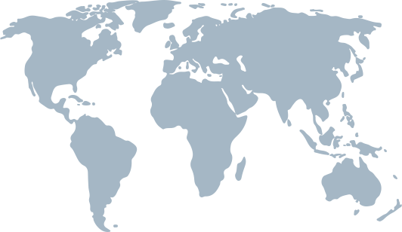
Global & Local Prevalence of Overweight & Obesity
Globally, 39% of adults aged 18 & above were overweight, whereas 13% were obese in the year 2016
Malaysia is the most obese country in Southeast Asia, with a prevalence of 15.4%
Out of this, 1 in 2 Malaysians (50.1%) of Malaysians are either overweight or obese; 30.4% being overweight and 19.7% obese
33.2% of adults from the B40 group were obese
Most Obese Countries. (2020). World Population Review. https://worldpopulationreview.com/country-rankings/most-obese-countries
National Health and Morbidity Survey. (2019). Ministry of Health, Malaysia. http://www.iku.gov.my/images/IKU/Document/REPORT/NHMS2019/Fact_Sheet_NHMS_2019-English.pdf
Obesity and overweight. Who.int. (2020). https://www.who.int/news-room/fact-sheets/detail/obesity-and-overweight.

Slide 6
Problem Statement
Obesity is a major public health burden due to its link to the development of non-communicable diseases (NCD) such as diabetes, ischaemic heart disease and certain types of cancer
Emerging telemedicine practices and existing reports on the prevalence of obesity often rely on self-reported anthropometric measurements. However, possible under-reporting of weight questions the reliability of these practices and the data collected via self-administered questionnaires
Al-Goblan, A. S., Al-Alfi, M. A., & Khan, M. Z. (2014). Mechanism linking diabetes mellitus and obesity. Diabetes, Metabolic Syndrome and Obesity: Targets and Therapy, 7, 587–591. https://doi.org/10.2147/DMSO.S67400
De Pergola, G., & Silvestris, F. (2013). Obesity as a major risk factor for cancer. Journal of Obesity, 2013, 291546. https://doi.org/10.1155/2013/291546
Ghee, L. K. (2016). A Review of Adult Obesity Research in Malaysia. 71, 19.
Obesity and overweight. Who.int. (2020). https://www.who.int/news-room/fact-sheets/detail/obesity-and-overweight.

Slide 7

Research Questions
What is the prevalence of obesity in an urban poor (B40) community in Malaysia and what are the factors associated with it?
What is the frequency of under-reporting of weight in self-administered online questionnaires?
What are the possible roles of sociodemographic and psychological factors in the under-reporting of weight?

Slide 8
Objectives
To determine the prevalence of obesity among an urban poor (B40) population
To determine the association between sociodemographic factors, QoL & obesity (BMI)
To assess the accuracy of self-reported weight and identify factors associated with reporting accuracy

Slide 9

Rationale
By studying the prevalence, we are able to identify at-risk groups and propose more targeted approaches to improve health outcomes in this community.
By studying the factors associated, we are able to identify predictors for development of overweight & obesity.

Slide 10

02
Literature Review

Slide 11

Literature Review
Author(s) | Year | Key Finding(s) | Limitations
Ghee et al. | 2016 | Age: Overweight and obesity doubles to a peak in middle aged. Sex: more women are obese than men Ethnicity: Indians are more overweight than Chinese and Bumiputras Education: those with tertiary levels of education have the lowest prevalence Marital Status: Married had higher risk of obesity | Did not present data regarding the B40 community explicitly. Used data collected from self-reported weight measurements.
Galvan et al. | 2020 | Among the 341 participants from an urban poor community, 39.6% were obese. | No self-reported measurements to compare and therefore did not discuss under reporting.
National Health and Morbidity Survey. (2019). Ministry of Health, Malaysia. http://www.iku.gov.my/images/IKU/Document/REPORT/NHMS2019/Fact_Sheet_NHMS_2019-English.pdf
Andoy-Galvan, J. A., Lugova, H., Patil, S. S., Wong, Y. H., Baloch, G. M., Suleiman, A., Nordin, R., & Chinna, K. (2020). Income and obesity in an urban poor community: A cross-sectional study. F1000Research, 9. https://doi.org/10.12688/f1000research.22236.1
Notes:
Combine the last 2 columns: and make it limitations.
NHMS 2019 published data on the prevalence of obesity in B40
Didn’t use international studies because Malaysian data was available

Slide 12

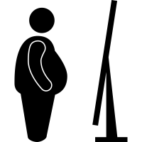
Author(s) | Year | Key Finding(s) | Limitations
Mauricio et al. | 2018 | Morbidly obese individuals presented with worse quality of life compared to non-obese individuals. | Is an international review (Brazil) Did not use WHOQOL-BREF Questionnaire Different cut off values used in classification of BMI No discussion regarding self-reported measurements
King et al. | 2018 | Lower social desirability scores were associated with a greater degree of under-reporting body weight. | Not a local study (U.S.A) Small sample size (n = 53) Participants were college students
Mauricio de Sant Anna Jr, Ana Carolina Manzi, Marco Orsini, Eduardo Tavares Lima Trajano, & Marcos RG de Freitas. (2018). Quality of Life and Obesity: Challenge of a Contemporary Society.
King, B. M., Cespedes, V. M., Burden, G. K., Brady, S. K., Clement, L. R., Abbott, E. M., Baughman, K. S., Joyner, S. E., Clark, M. M., & Pury, C. L. S. (2018). Extreme under‐reporting of body weight by young adults with obesity: Relation to social desirability. Obesity Science & Practice, 4(2), 129–133. https://doi.org/10.1002/osp4.153
Notes:
Relate to 2nd objective (4th becomes 3rd)

Slide 13


Author(s) | Year | Key Finding(s) | Limitations
Yannakoulia et al. | 2006 | Sex: Women were 9 times more likely to be under-reporters than men Age: A 10-year increase in age was associated with a 48% higher likelihood of being an under-reporter | International study (Greece) Study included participants from urban and rural areas Did not use WHOQOL-BREF Questionnaire Different cut off values used in classification of BMI
Yannakoulia, M., Panagiotakos, D. B., Pitsavos, C., & Stefanadis, C. (2006). Correlates of BMI misreporting among apparently healthy individuals: The ATTICA study. Obesity (Silver Spring, Md.), 14(5), 894–901. https://doi.org/10.1038/oby.2006.103

Slide 14
Research Gaps
Obesity has been associated with sociodemographic factors in previous studies, but its association with quality of life has yet to be fully explored, especially in the low-income (B40) population of Malaysia.
The accuracy of self-reported anthropometric measurements (especially weight) and its association with obesity has not been well-established.

Slide 15

03
Methodology

Slide 16
Data Collection Flowchart
PPR Sri Pantai
N=64
1
6
Data collection for sociodemographic & QoL profile
2
5
On-site measurement of height & weight
Dissemination of self-administered online questionnaire
Completion of online survey
3
4
Approximately 3500 residents
Excluded: Remaining 43 participants not present for anthropometric measurements
Included: residents 18 and above, with handphone
64 participants
Researchers → Taylor’s Community Department → Community leaders of PPR Sri Pantai → Floor leaders (floors 1-21 of Blocks 100 & 102) → Residents
107 participants

Slide 17
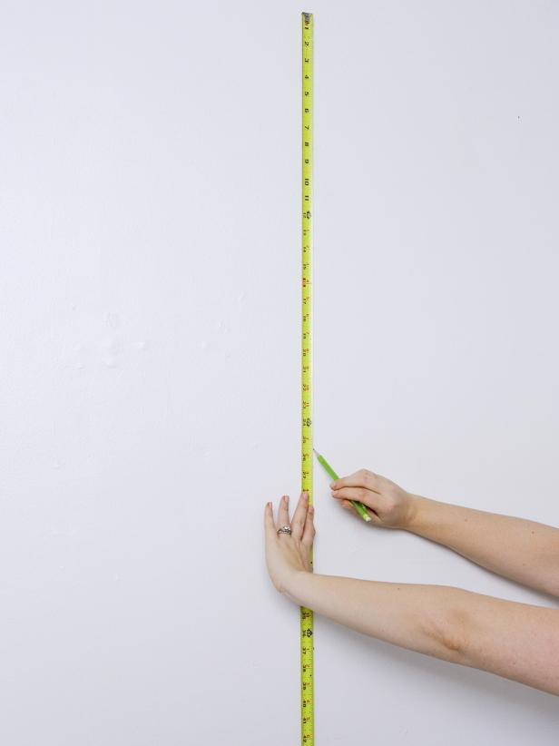
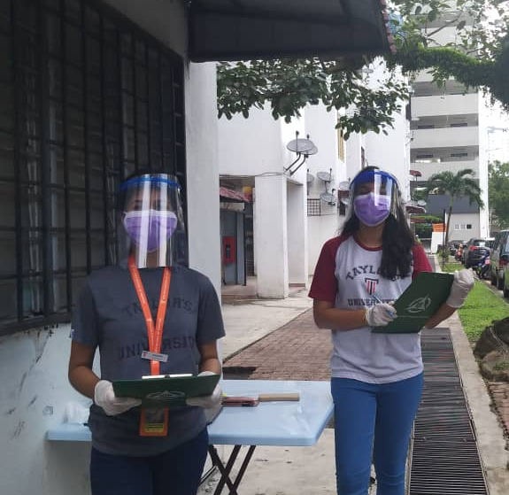
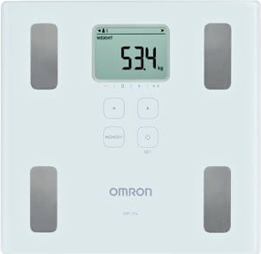
Measurements of Height and Weight
Height
Weight
Notes:
Remove the text

Slide 18
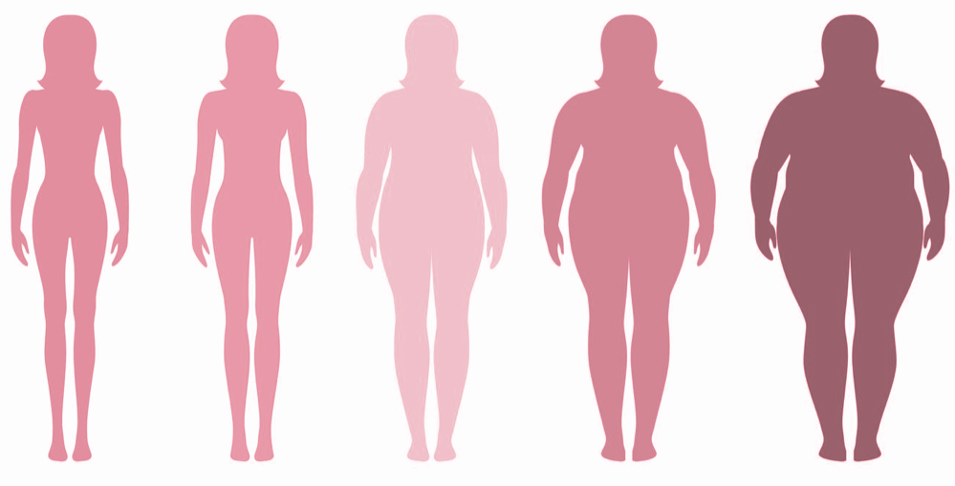
Body Mass Index
BMI = weight(kg)
height (m²)
Body mass index (BMI) is an index of weight-for-height that is commonly used to classify overweight and obesity in adults.
Malaysian BMI cut-off points
Classification | BMI (kg/m²)
Underweight | <18.5
Normal | 18.5-22.9
Overweight Pre-obese Obese I Obese II Obese III | 23.0 23.0-27.4 27.5-34.9 35.0-39.9 40.0
Underweight
Normal
Overweight
Pre-obese
Obese
Obesity. (2020). World Health Organization. https://www.who.int/topics/obesity/en/
Ismail IS, Bebakar M, & Noor I. (2004). Clinical Practice Guidelines (CPGs). Academy of Medicine of Malaysia
Notes:
For statistical analysis of our data, we merged overweight and pre-obese to become overweight, and the 3 obese classes into one obese category.

Slide 19
04
Results

Slide 20

Sociodemographics of our Participants
Variables | n (%)
Age 18-29 30-39 40-49 50-59 >60 Sex Female Male Ethnicity Bumiputra Indian Level of Education Without tertiary education With tertiary education Marital Status Not currently married Married Widow Other | 9 (14.1) 15 (23.4) 20 (31.3) 10 (15.6) 10 (15.6) 57 (89.1) 7 (10.9) 54 (84.4) 10 (15.6) 1 (1.6) 5 (7.8) 50 (78.1) 1 (1.6) 6 (9.4) 1 (1.6)
The majority of participants were 40-49 years old, female, bumiputra, had a secondary level of education and married.

Slide 21
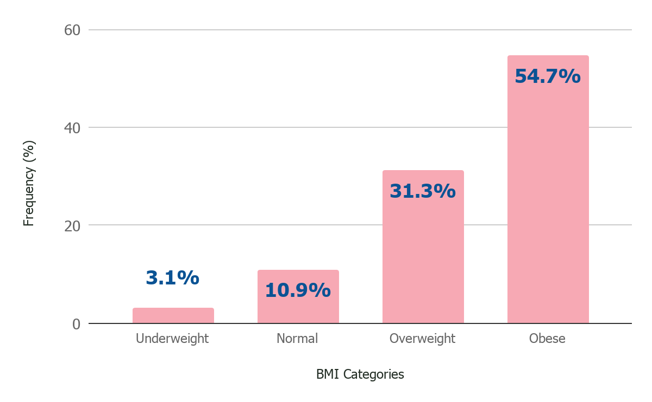
Distribution of BMI among adults according to BMI classification (N=64)
86%
Variables | BMI (kg/m²) | n (%)
Underweight Normal Overweight Obese | <18.5 18.5-22.9 23.0-27.4 ≥ 27.5 | 2 (3.1) 7 (10.9) 20 (31.3) 35 (54.7)
were either overweight or obese

Slide 22
Association between Sociodemographic Factors and BMI categories
Variables | Underweight/Normal n (%) | Obese/Overweight n (%) | X² | p-value
Age 18-29 30-39 40-49 50-59 >60 Sex Female Male Ethnicity Bumiputra Indian Level of Education Without tertiary education With tertiary education Marital Status Not currently married Married | 1 (11.1) 4 (26.7) 1 (5) 2 (20) 1 (10) 9 (15.8) 0 (0) 7 (13) 2 (20) 7 (12.3) 2 (28.6) 4 (13.3) 5 (14.7) | 8 (88.9) 11 (73.3) 19 (95) 8 (80) 9 (90) 48 (84.2) 7 (100) 47 (87) 8 (80) 50 (87.7) 5 (71.4) 26 (86.7) 29 (85.3) | 3.824ª 1.286ª 0.346ª 1.369ª 0.025ª | 0.430 0.257 0.557 0.242 0.875
We found no significant association between the tested sociodemographic variables and the BMI categories

Slide 23
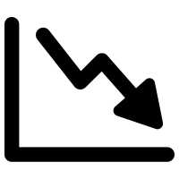
Correlation between QoL & BMI (N=64)
Variables | r | p-value
Physical Psychological Social Environmental | -0.171 -0.359 -0.950 -0.082 | 0.177 0.004 0.457 0.521
Results showed that BMI was negatively correlated to QoL in the psychological domain (r= -0.359, p=0.004)
HIGHER BMI = POOR PSYCHOLOGICAL WELLBEING

Slide 24
Mean Difference between self-reported and measured weight (N=64)
n | Mean (SD) | t-test | p-value | 95% Confidence Interval
 |  |  |  | Lower | Upper
64 | 5.7 (14.5) | 3.159 | 0.002 | 2.1 | 9.3
The difference between self-reported and measured weight was statistically significant (p=0.002), and participants were under-reporting their weights with an average misreporting* of 5.7 kg from their actual weight.
*Misreporting was defined as a deviation of more than 1.5 kg from a participant’s actual weight.

Slide 25
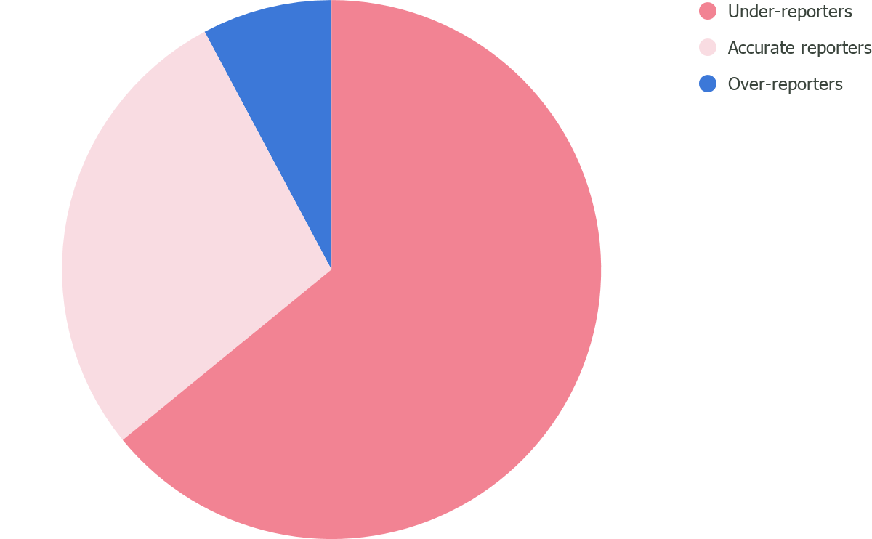
Participants who under-reported, accurately reported or over-reported weight (N=64)
64.1%
were under-reporting their weight
Measured Weight | n (%)
Under-reporters Accurate reporters Over-reporters | 41 (64.1%) 18 (28.1%) 5 (7.8%)

Slide 26
Factors associated with under-reporting of weight (N=64)
Significant association was found between under-reporting of weight with age and ethnicity
For marital status, there was almost 20% in difference between the two categories, but the p-value was >0.05. The p-value of 0.093 would possibly be accepted at 10% significance, since the sample size was small.
Under-reporting of weight was negatively correlated to QoL in the psychological domain
Variables | Yes n (%) | No n (%) | X²/r | p-value
Age 18-29 30-39 40-49 50-59 >60 Sex Female Male Ethnicity Bumiputra Indian Level of Education Without tertiary education With tertiary education Marital Status Not currently married Married Quality of Life Physical Psychological Social Environmental | 6 (66.7) 12 (80.0) 17 (85.0) 3 (30.0) 3 (30.0) 36 (63.2) 5 (71.4) 39 (72.2) 2 (20.0) 35 (63.2) 5 (71.4) 16 (53.3) 25 (73.5) | 3 (33.3) 3 (20) 3 (15) 7 (70) 7 (70) 21 (36.8) 2 (28.6) 15 (27.8) 8 (80) 21 (36.8) 2 (28.6) 14 (46.7) 9 (26.5) | 15.569ª 0.185ª 9.995ª 0.185ª 2.824ª -0.090 -0.282 -0.055 -0.021 | 0.004 0.667 0.002 0.667 0.093 0.477 0.024 0.663 0.868

Slide 27

05
Conclusions & Recommendations

Slide 28
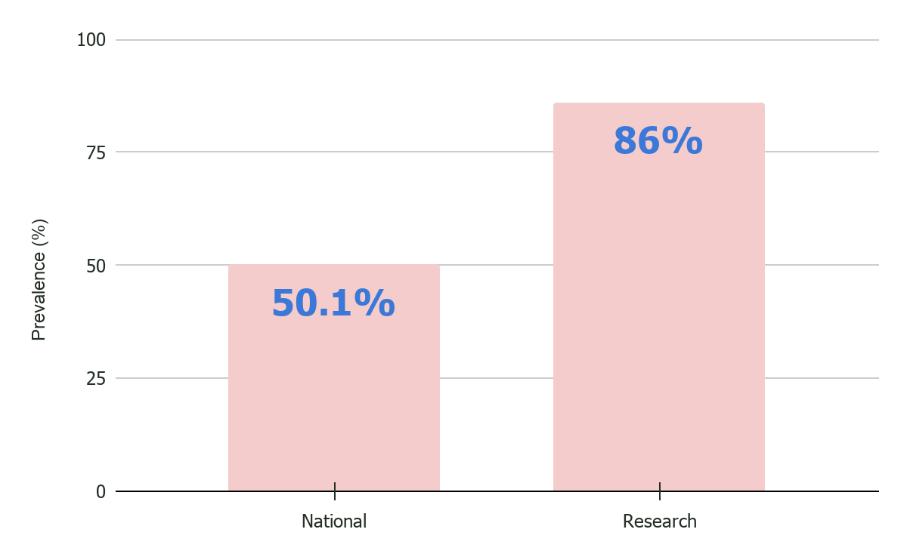
Discussion of Outcomes
Prevalence of Obesity
In comparison to the national overweight and obesity prevalence of 50.1%, the prevalence in the B40 community of PPR Sri Pantai was markedly higher at 86%
National Health and Morbidity Survey. (2019). Ministry of Health, Malaysia. http://www.iku.gov.my/images/IKU/Document/REPORT/NHMS2019/Fact_Sheet_NHMS_2019-English.pdf

Slide 29
Discussion of Outcomes
86%
64.1%
Higher BMI and under-reporting of weight were associated with lower scores in the psychological domain of QoL
Most of the participants (86%) were either overweight or obese.
A majority of participants (64.1%) were under-reporting their weight.
Under-reporting was seen more in married Bumiputras aged 40-49
Participants were under-reporting their weights by an average of 5.7 kg

Slide 30
Conclusions
Sociodemographics
BMI, Under-reporting & Psychological Wellbeing
Regardless of sociodemographics, the prevalence of overweight and obesity among the residents of this urban poor community was significantly higher than the reported national prevalence.
Participants with higher BMI and participants who under-reported their weight exhibited poorer scores in the psychological domain of our assessment of QoL.
Notes:
Need to elaborate more when presenting. Include points from discussion in report.

Slide 31
Factors to Consider
Movement Control Order
Large-scale explorative studies
Lack of equal representation of Indians and Chinese
Development of well-rounded policies
LIMITATIONS
RECOMMENDATIONS
Sample population was relatively small due to limitations in survey dissemination
To effectively establish trends on obesity, QoL and under-reporting
To deter the pervasiveness of obesity in this community
Possibility of undercoverage bias

Slide 32
Thank you!
ANY QUESTIONS?
ACKNOWLEDGEMENTS
DR. JO ANN ANDOY-GALVAN
PROF. KARUTHAN CHINNA

Slide 33
References
Obesity. (2020). World Health Organization. https://www.who.int/topics/obesity/en/
WHOQOL: Measuring Quality of Life. (2020). World Health Organization.
Most Obese Countries. (2020). World Population Review. https://worldpopulationreview.com/country-rankings/most-obese-countries
National Health and Morbidity Survey. (2019). Ministry of Health, Malaysia. http://www.iku.gov.my/images/IKU/Document/REPORT/NHMS2019/Fact_Sheet_NHMS_2019-English.pdf
Obesity and overweight. Who.int. (2020). https://www.who.int/news-room/fact-sheets/detail/obesity-and-overweight
Al-Goblan, A. S., Al-Alfi, M. A., & Khan, M. Z. (2014). Mechanism linking diabetes mellitus and obesity. Diabetes, Metabolic Syndrome and Obesity: Targets and Therapy, 7, 587–591. https://doi.org/10.2147/DMSO.S67400
De Pergola, G., & Silvestris, F. (2013). Obesity as a major risk factor for cancer. Journal of Obesity, 2013, 291546. https://doi.org/10.1155/2013/291546
Ghee, L. K. (2016). A Review of Adult Obesity Research in Malaysia. 71, 19.
Ismail IS, Bebakar M, & Noor I. (2004). Clinical Practice Guidelines (CPGs). Academy of Medicine of Malaysia
Andoy-Galvan, J. A., Lugova, H., Patil, S. S., Wong, Y. H., Baloch, G. M., Suleiman, A., Nordin, R., & Chinna, K. (2020). Income and obesity in an urban poor community: A cross-sectional study. F1000Research, https://doi.org/10.12688/f1000research.22236.1
Mauricio de Sant Anna Jr, Ana Carolina Manzi, Marco Orsini, Eduardo Tavares Lima Trajano, & Marcos RG de Freitas. (2018). Quality of Life and Obesity: Challenge of a Contemporary Society.
King, B. M., Cespedes, V. M., Burden, G. K., Brady, S. K., Clement, L. R., Abbott, E. M., Baughman, K. S., Joyner, S. E., Clark, M. M., & Pury, C. L. S. (2018). Extreme under‐reporting of body weight by young adults with obesity: Relation to social desirability. Obesity Science & Practice, 4(2), 129–133. https://doi.org/10.1002/osp4.153
Yannakoulia, M., Panagiotakos, D. B., Pitsavos, C., & Stefanadis, C. (2006). Correlates of BMI misreporting among apparently healthy individuals: The ATTICA study. Obesity (Silver Spring, Md.), 14(5), 894–901. https://doi.org/10.1038/oby.2006.103

