Slide 1


CHARACTERISING BODY IMAGE,
BODY APPRECIATION AND
BODY ESTEEM AMONG
URBAN CHILDREN IN MALAYSIA
Presented by :
Shuwaathi Thamil Manni
Perdana University- RCSI School of Medicine
Email :18924482@perdanauniversity.edu.my
AUTHORS :
Shuwaathi Thamil Manni, Durga Shanmuganathan, Aruvvi Malar Balakrishnan, David Barron, Mogana Darshini Ganggayah, Anne Jamaludin, Kanakeswary Karisnan

Slide 2
DEFINITION
PERCEPTION OF BODY WEIGHT
How one evaluates his or her body image with their feelings, behaviours and thoughts regarding weight and physical appearance
BODY IMAGE
How one recognizes, feels, thinks and acts towards his/her body
BODY APPRECIATION
Accepting, having appropriate views or beliefs towards and respecting or appreciating one’s body
BODY ESTEEM
  Self-concept that is been most consistently associated with weight, and includes the attitudes, evaluations, and feelings an individual holds about his or her own body.

Slide 3
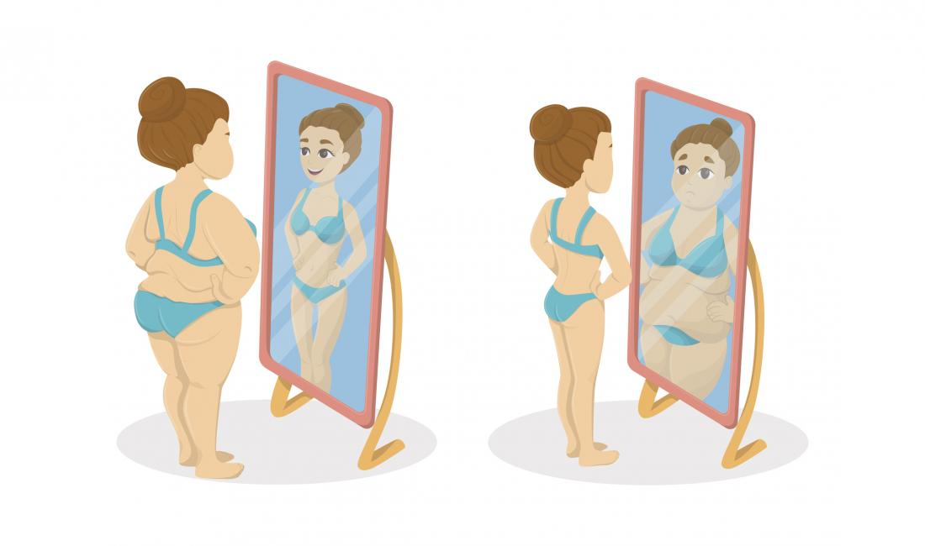
INTRODUCTION
PERCEPTION OF BODY WEIGHT
Childhood obesity
BODY ESTEEM
BODY APPRECIATION
BODY IMAGE

Slide 4
OBJECTIVES
To determine the children’s perception of their body weight status
To elucidate the association between children’s body weight with body appreciation and body esteem
To examine the gender differences in body esteem and body appreciation
To evaluate the effect of body esteem and body appreciation score on dieting behaviour.

Slide 5
METHODOLOGY
Design & Setting
Interview style questionnaires
Ethical consideration
Approval
Participants
7-12 years old
Consent obtained
333 children
192 girls & 141 boys
Primary schools in Selangor, Malaysia

Slide 6
Study Instrument
Children Body Image Scale (CBIS)
Body Appreciation Scale-2 (BAS-2C)
Body Esteem Scale (BES)
Dieting behaviour
Data Collection
Children were interviewed on a one-to-one basis by trained assessors
Children’s BMI Z-score calculated using measured Height & Weight
Data analysis
SPSS
Frequency of demographic data
Mean & Standard deviations of perceived and ideal body image, BMI Z-score, gender, BES and dieting behaviours.
Chi-squared analysis to determine the associations

Slide 7
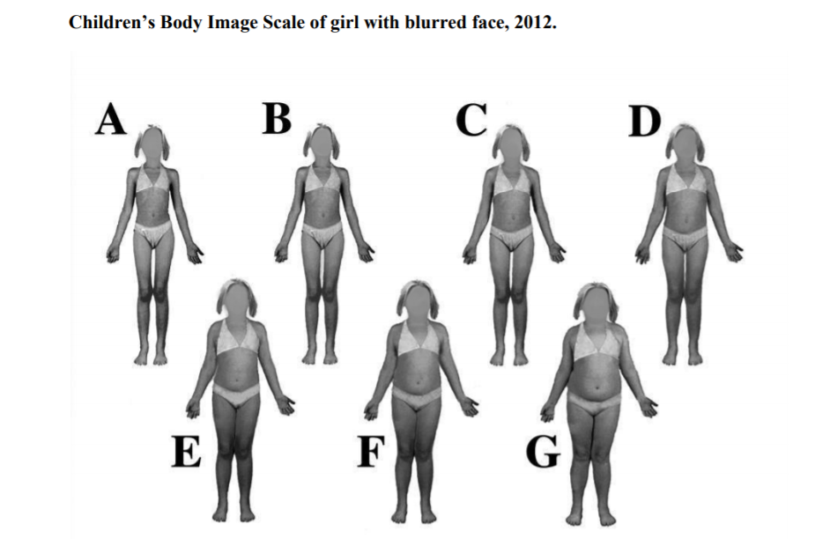
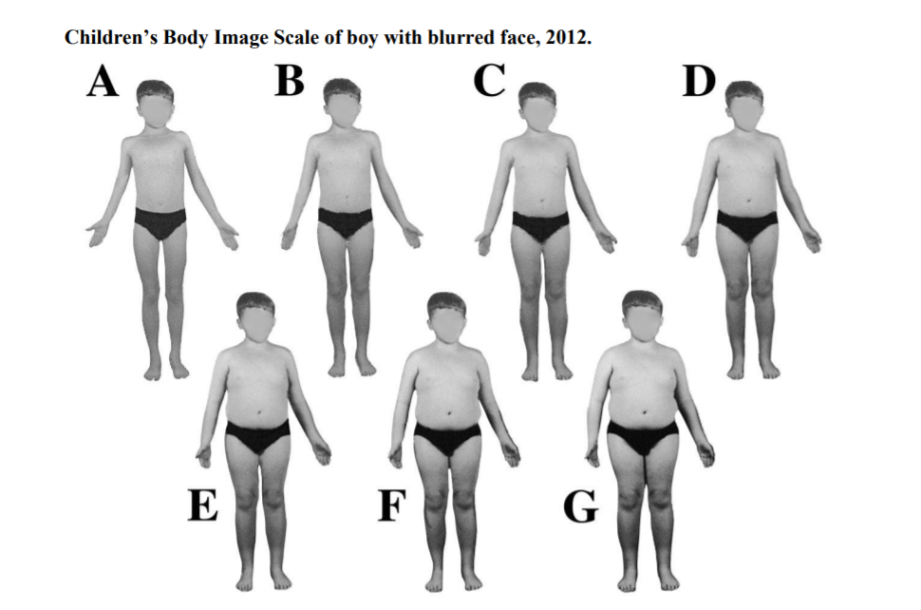
Questions asked regarding CBIS to evaluate children’s perception on body weight and their ideal body image
CHILDREN’S BODY IMAGE SCALE (CBIS)
Figure 1
Figure 2

Slide 8
DEMOGRAPHIC CHARACTERISTICS

Slide 9
RESULTS
Significant association was shown between the actual-perceived score and gender (p=0.020).
The boys (discrepancy score= 0.40) were more inaccurate in perceiving their body weight status compared to girls (discrepancy score=0.27).
15.6% of the boys and 13.5% of girls underestimated their body weight and 10.6% of boys and 2.6% of girls overestimated their weight.
Figure 3 : Underestimation, accurate estimation and overestimation of body weight status by gender

Slide 10
Variables | Children’s perceived body weight | Children’s ideal body image | Dieting Behaviours | BMI Z- score | Body disssatisfaction
BES | 0.002* | 0.866 | 0.043* | 0.000* | 0.006*
BAS | 0.725 | 0.628 | 0.730 | 0.870 | 0.462
Table 1 : Association between Body Esteem Scale (BES) and Body Appreciation Scale (BAS) with Children’s perceived body weight, ideal body image, dieting behaviours,body dissatisfaction, BMI Z-Score according to BMI. Note: * indicates statistical significance (p<0.05)
Significant association between
body esteem and BMI Z-score (p=0.000)
body esteem and perceived body weight (p=0.002)
body esteem and dieting behaviours (p=0.043).
body esteem and body dissatisfaction
Gender : BES and girls (p =0.000) as well as boys and BES (p=0.043).

Slide 11
DISCUSSION
Most children, 74% of boys and 84% of girls accurately estimated their body weight.
Body image dissatisfaction score showed that the children desired to be thinner, with boys less accurately perceiving their body weight than girls.
Majority of children (98%) showed high body appreciation of which 68% were normal weight children
Majority of children with measured normal body weight status showed a High body esteem.
Among the children with high body esteem, 41% perceived that they are underweight and 50% perceived they are with normal body weight.

Slide 12
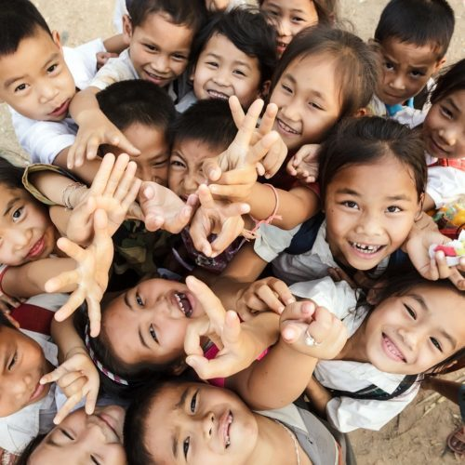
Most children accurately perceived their body weight and generally have a high body appreciation and body esteem.
Childhood body weight and shape issues emotionally and psychologically affect the children
Major healthcare concern as this can foreshadow serious health issues during their adulthood
Behavioural interventions and counselling targeting children with low scores in the upcoming phases of their life are essential to support them .
CONCLUSION

Slide 13

A special thanks to my supervisor, Dr Kanakeswary Karisnan for guiding me throughout this research project and my seniors for working with me on this research.
I would like to extend my gratitude to the children that participated in this research enthusiastically and to the headmasters and teachers of the schools involved for cooperating with us on the process of data collection.
Lastly, thank you for allowing me the opportunity to expand my skills, learn and gain experience through this platform.
Thank you for listening !

