Slide 1

A SCIENCE OF GREAT IMPORTANCE: STUDYING EPIDEMIOLOGY IN THE MIDST OF COVID-19 PANDEMIC
Halyna Lugova
Faculty of Medicine and Defence Health
National Defence University of Malaysia

Slide 2
EPIDEMIOLOGY
•A study of health in populations
•Understanding the causes, numbers, distribution, control and prevention of disease

Slide 3
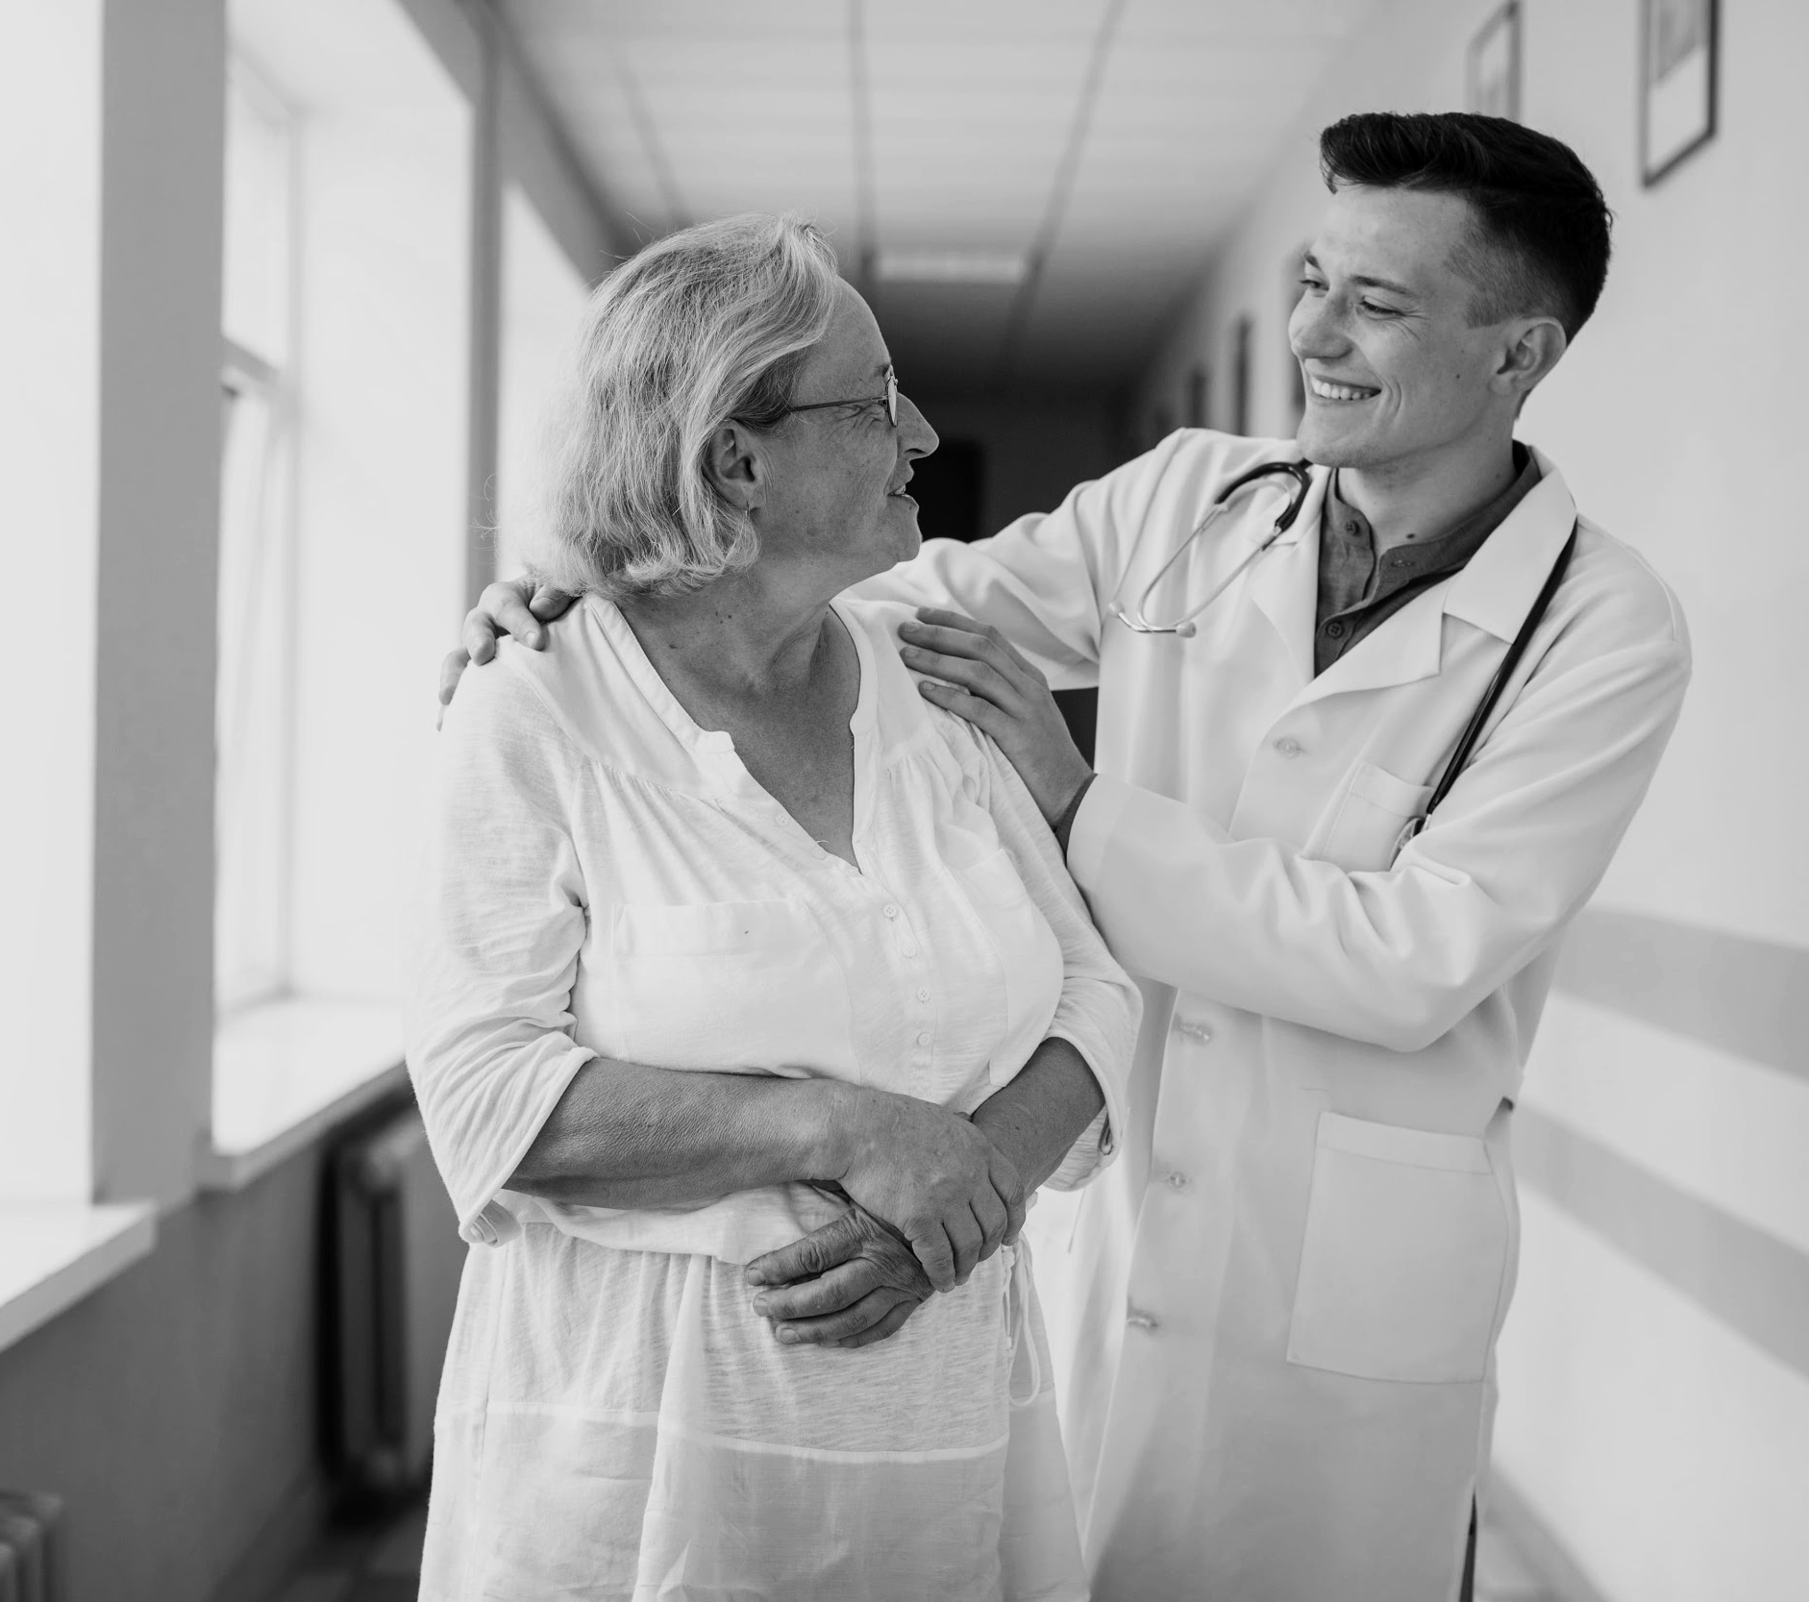
HISTORICAL CONTRIBUTIONS
  Triumphs over communicable diseases
  Understanding nutritional deficiencies
  Declines in cardiovascular disease mortality
  Declines in morbidity and mortality associated with tobacco use

Slide 4
TIME
DISTRIBUTION OF HEALTH CONDITIONS
PLACE
PERSON
EPIDEMIOLOGY
HEALTH OUTCOMES
CAUSATION
EXPOSURES
INFECTIOUS, RADIOLOGICAL OR CHEMICAL AGENTS
ENVIRONMENTAL HAZARDS
MEDICAL OR PUBLIC HEALTH INTERVENTIONS
SOCIAL DETERMINANTS OF HEALTH

Slide 5

ADDRESSING COVID-19 PANDEMIC CHALLENGES
‘Each generation receives its particular impression of epidemic diseases’
Flexner, 1922
Data sharing through online platforms
Interdisciplinary collaboration
Rigorous descriptive epidemiology
Knowledge transition

Slide 6
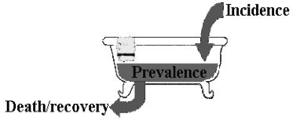
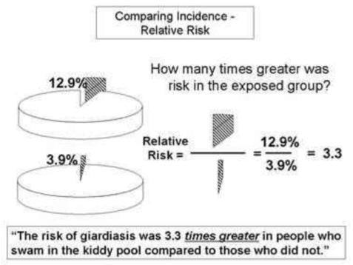
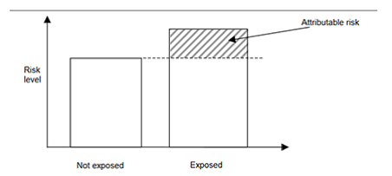
EPIDEMIOLOGY IN MEDICAL EDUCATION

Slide 7
EPIDEMIOLOGY IN MEDICAL EDUCATION DURING THE PANDEMIC
COVID-19 has increased the demand of Public Health professionals
Real life experience of studying

Slide 8
THANK YOU FOR ATTENTION

